Slide 1



Accelerating synthesis science through reproducible science practices
Matthew B. Jones
National Center for Ecological Analysis and Synthesis
University of California Santa Barbara
@metamattj
jones@nceas.ucsb.edu
https://orcid.org/0000-0003-0077-4738

Slide 2

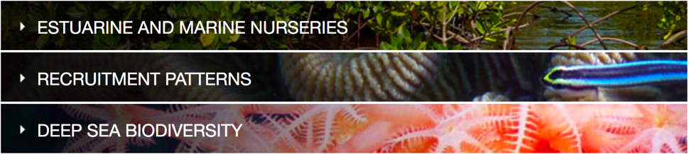
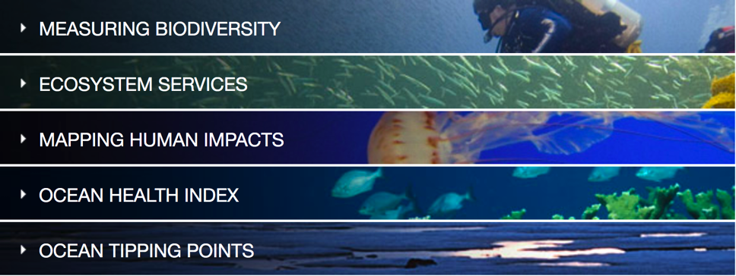
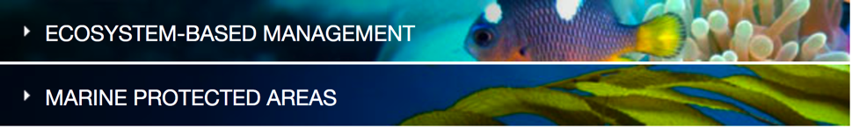
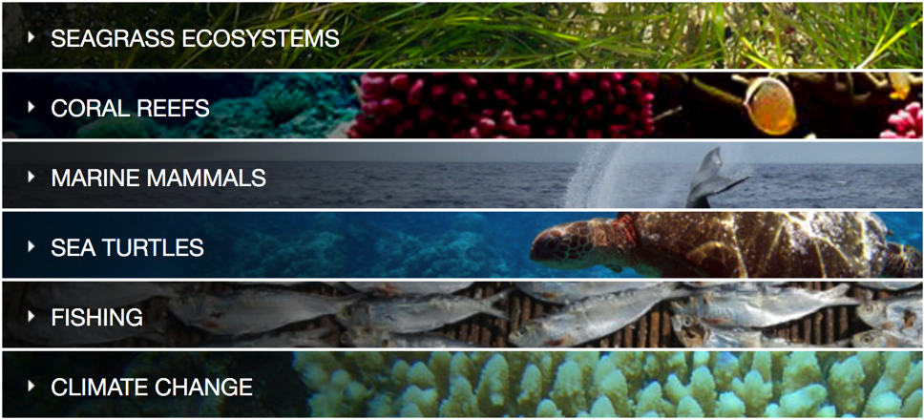
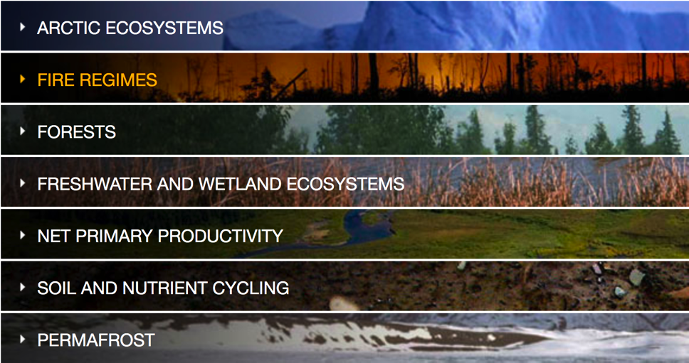
Ecological Synthesis
Marine Systems
Understanding Ocean Health
Threats and Population Declines
Climate and Ecosystems

Slide 3


Reproducible
Science
Provenance
Citation
Synthesis

Slide 4
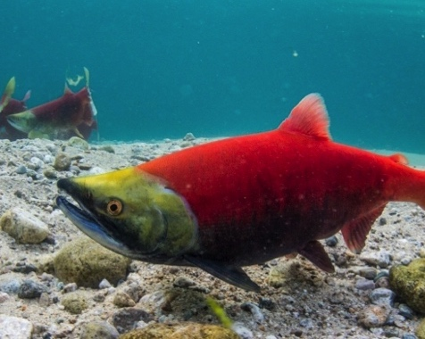
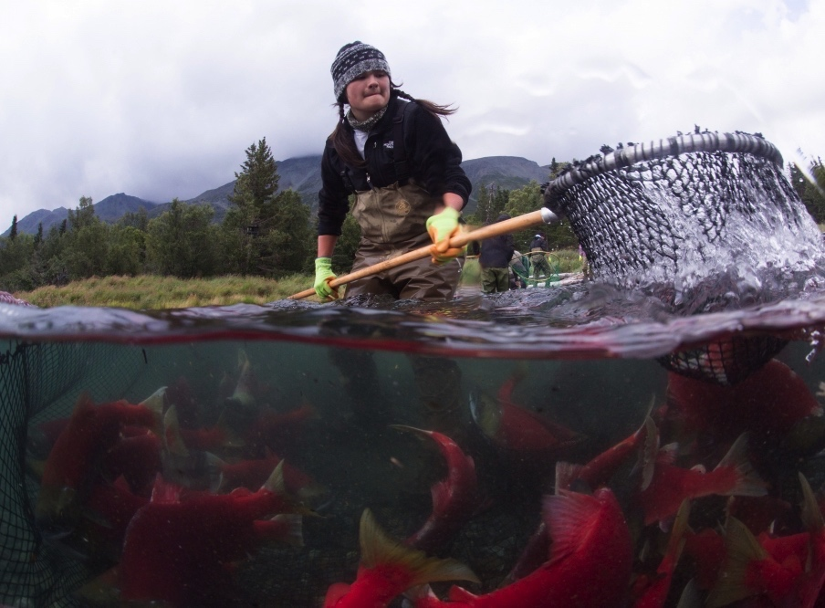
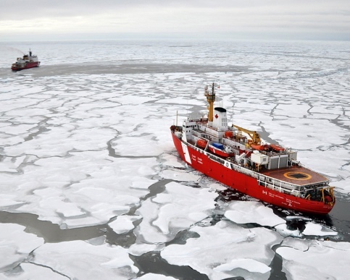
Reproducible Science
Climate Change
Fisheries
Sustainabiity
Subsistence
Science
Governance
Regulation
Policy

Slide 5
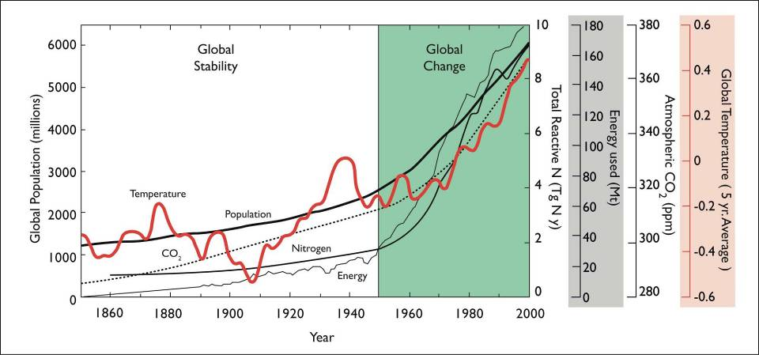
Trust in Science
What data?
What methods?
What parameter settings?
Can we trust these data and methods?
Smith et al. (2009) Ecology doi:10.1890/08-1815.1

Slide 6
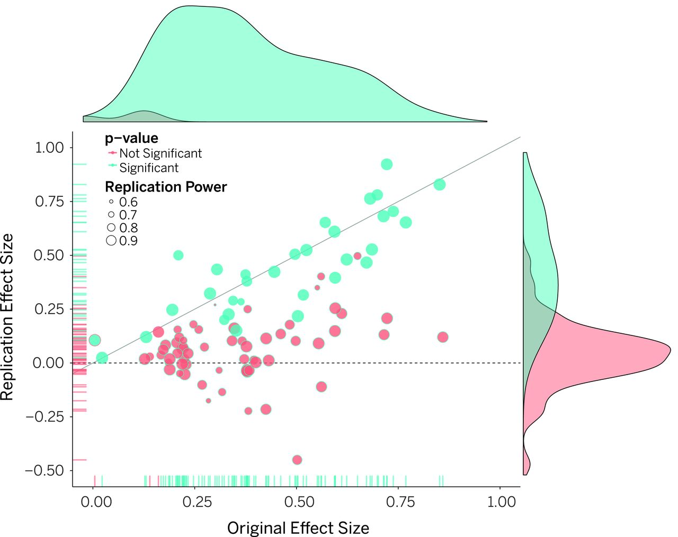
“Most research findings are false for most research designs and for most fields”
Reproducibility Crisis
“Most replication effects were smaller than original results”
Ioannidis, 2005
Open Science Collaboration, 2015
doi:10.1126/science.aac4716
Notes:
Bertram: Ioannidis doesn’t specifically talk about computational reproducibility, right? Rather it includes all kinds of issues that negatively affect reproducibility.
So I think it is worth saying here or on the next slide that the focus of the DataONE work is on computational transparency and reproducibility.
The transparency also helps some of the non-computational (e.g. statistical / method) issues: e.g. a YesWorkflow diagram can help understand the experiment design.
Similarly multi-run provenance information could expose not just the “ideal runs”, but also runs that were discarded.
But the focus is still computational transparency (what methods were used, in what order, with what inputs and params?)
and computational reproducibility (by providing e.g. the code to re-run the scripts).
Collaboration with Whole Tale project: simplify reproducibility further, by providing data + code + execution environment!

Slide 7
National Climate Assessment
“This report is the result of a three-year analytical effort by a team of over 300 experts, overseen by a broadly constituted Federal Advisory Committee of 60 members. It was developed from information and analyses gathered in over 70 workshops and listening sessions held across the country.”
Notes:
Bertram: something I’m usually saying here: the NCA authors had to “chase provenance” information to document how results, figures, etc. were derived from input sources, etc.
In the future, as more provenance-enabled environments such as DataONE become available, the need to manually chase provenance will be reduced, and more and more results will be available that already “come with provenance”.

Slide 8

Computational Reproducibility
Facilitate transparency by capturing and communicating scientific workflows
Increase trust in science
Stand on the shoulders of giants (build on work that came before)
Give credit for that secondary usage enabling easy attribution
Notes:
Bertram: One punchline that could be added:
… and ... It’s not science unless it’s reproducible!

Slide 9
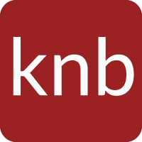

Practical Reproducibility
Preserve the data
Preserve the software workflow
Document what you did
Describe how to interpret it all
Notes:
Proceed through the 36 month project milestones in order.
Next, Matt Jones on provenance.

Slide 10
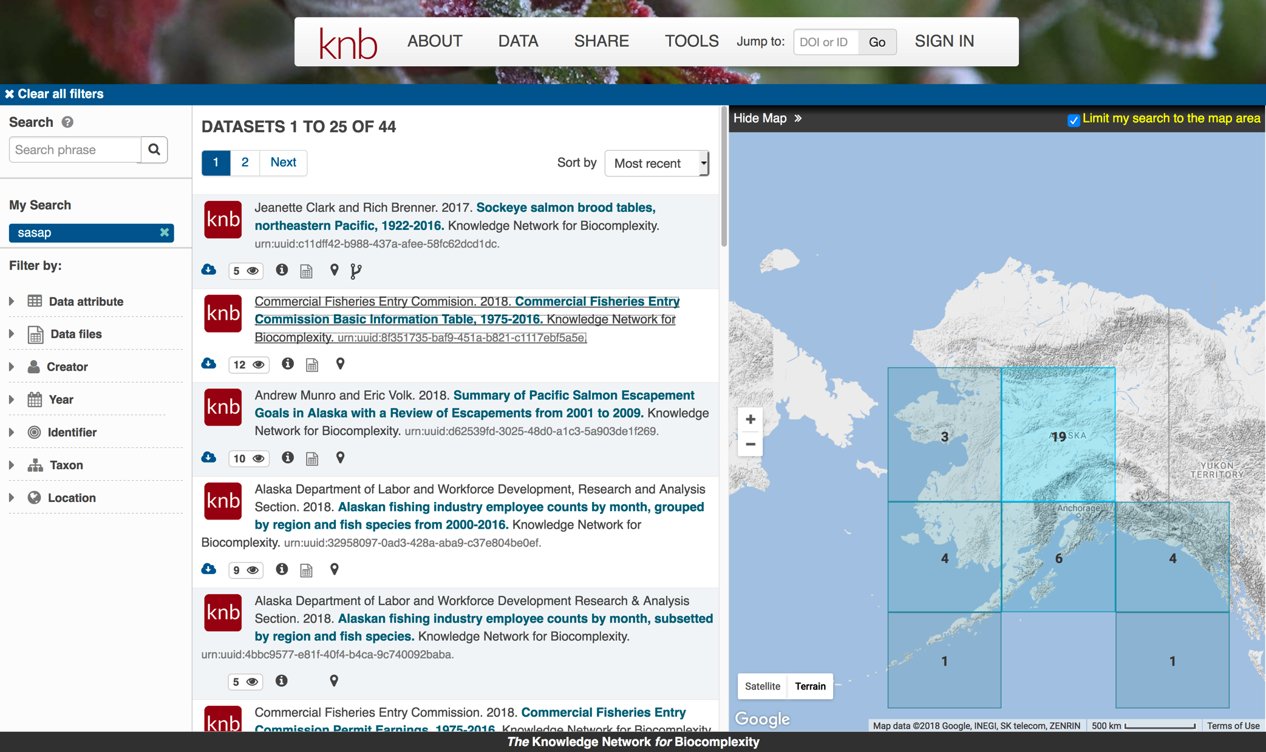
5000+ Trained

Slide 11
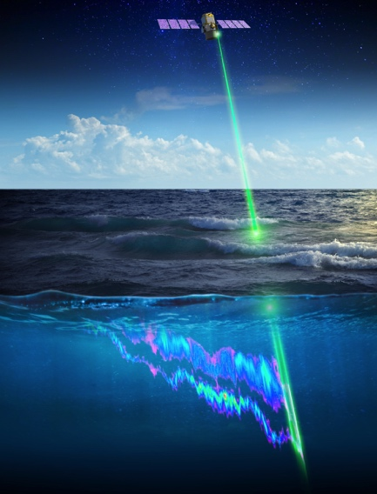
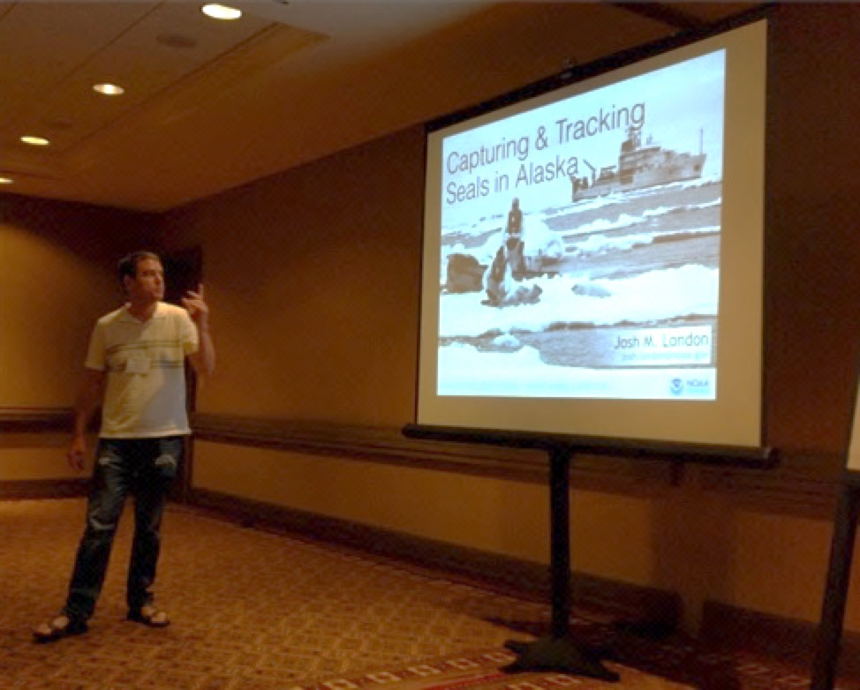





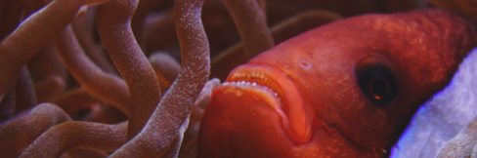
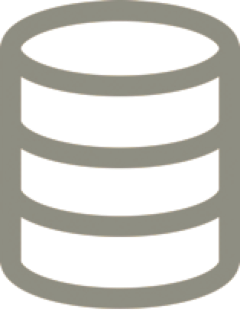



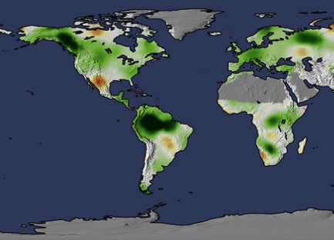
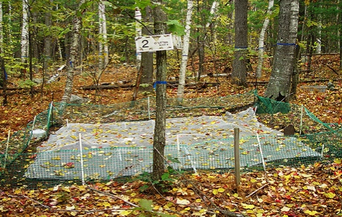
https://search.dataone.org
Global Data Coverage
800K Data Packages
25 Webinars
40 Repositories
143K Contributors
10,000 Users/Month
5000+ Trained

Slide 12


Reproducible
Science
Provenance
Citation
Synthesis

Slide 13
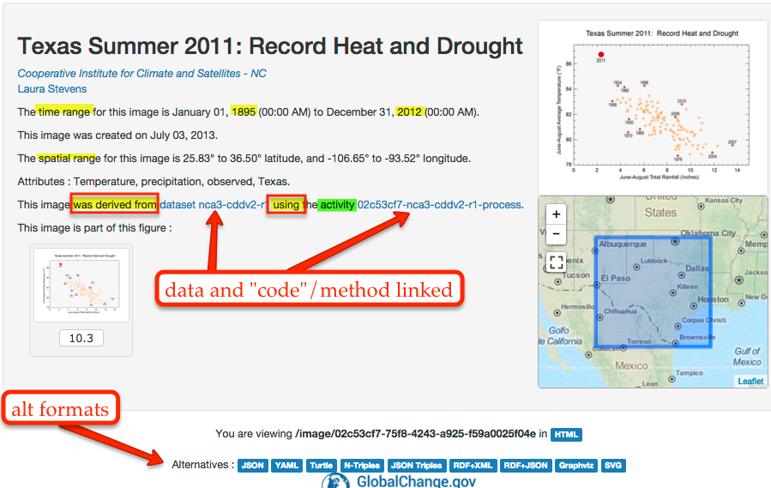
Computational Provenance
Origin, processing history of data
Input data
Workflow/scripts
Output data
Figures
Understand methods, dataflow, and dependencies

Slide 14
Provenance
Origin and processing history of artifacts
Prose
Formal Provenance Trace
Fully Executable Environment
Notes:
Bertram: Here I would probably not call this “Provenance” but e.g. “Provenance++” or “From Provenance to Reproducibility”
After all, the fully executable environment is primarily about reproducibility (rather than provenance)
Also: Suggest to expand “Formal Provenance Trace” to “Workflow & Provenance Trace”
(which is another way of saying: prospective & retrospective provenance)

Slide 15
Provenance in DataONE
Phase II Goal: Facilitate reproducible science
Track data derivation history
Track data inputs and outputs of analyses
Track analysis and model executions
Preserve and document software workflows
Link all of these to publications
Notes:
Bertram: Wordsmithing proposal:
Phase II Goal: To facilitate reproducible science …
... track data derivation history
... track ...
etc

Slide 16

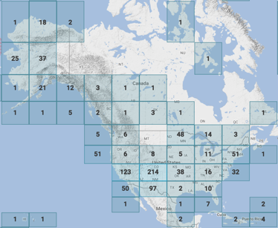
Provenance for Science Workflows
ProvONE – an extension of W3C PROV
See purl.dataone.org/provone-v1-dev
wasAttributedTo
map image
Scientist
wasGeneratedBy
R script
wasAssociatedWith
Notes:
BL: fontification

Slide 17
Provenance for Science Workflows
ProvONE – an extension of W3C PROV
See purl.dataone.org/provone-v1-dev
wasAttributedTo
map image
wasDerivedFrom
Scientist
wasGeneratedBy
R script
CSV data
wasAssociatedWith
used
Notes:
BL: fontification

Slide 18
Data Package with Provenance
Data Package 1
(doi:10.5063/F1Z899CZ)
cito:documents
metadata
science data
science data
data granule 1
OAI-ORE with ProvONE trace
prov:
derived from
prov:used
software
figures
prov:generated
Notes:
BL: fontify

Slide 19
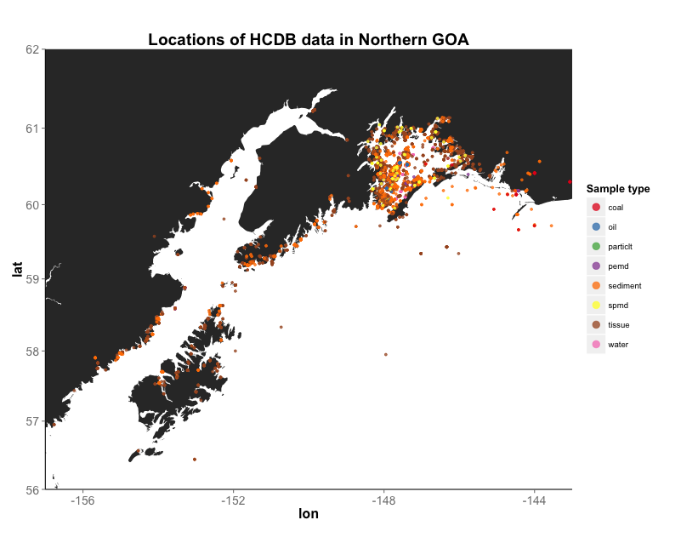
Hydrocarbon Data Example
Mark Carls. 2017. Analysis of hydrocarbons following the Exxon Valdez oil spill, Gulf of Alaska, 1989 - 2014. Arctic Data Center.
Notes:
BL: enlarged fig

Slide 20
Publishing Data Workflows
Dataset C
Dataset D
Data 1
Data 2
Image 1
Download
Script
Integration
Script
Data 5
Mapping
Script
Data 3
Image 2
Data 4
Notes:
BL: font-colors improved

Slide 21
Hydrocarbon Data Example
Complex Workflows
Simplified view of complex workflows

Slide 22
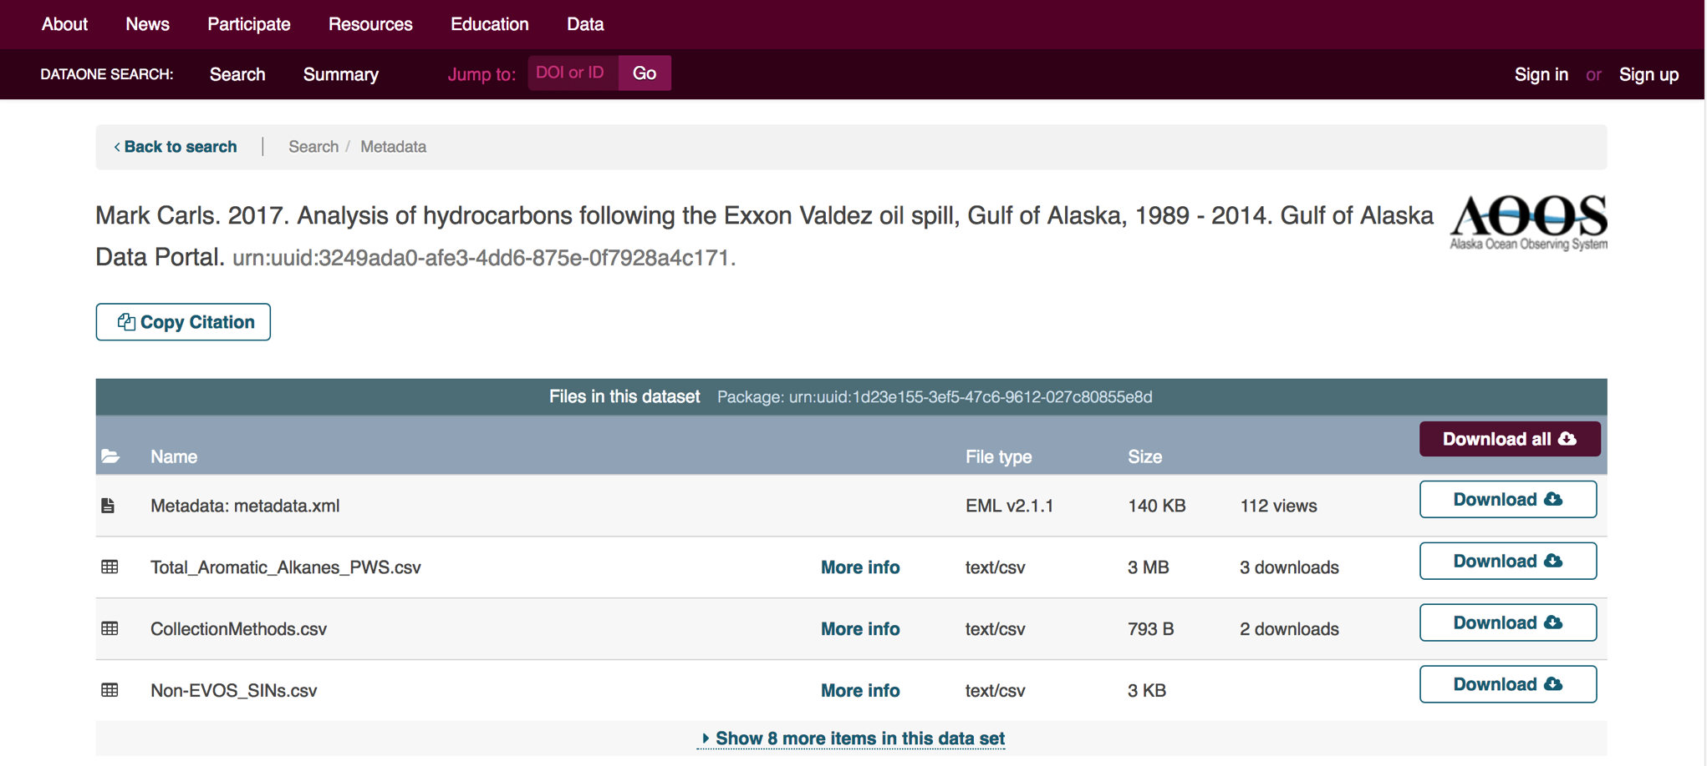
Provenance Display
DataONE Search
Notes:
Flip to website at:
https://search.dataone.org/#view/urn:uuid:3249ada0-afe3-4dd6-875e-0f7928a4c171

Slide 23
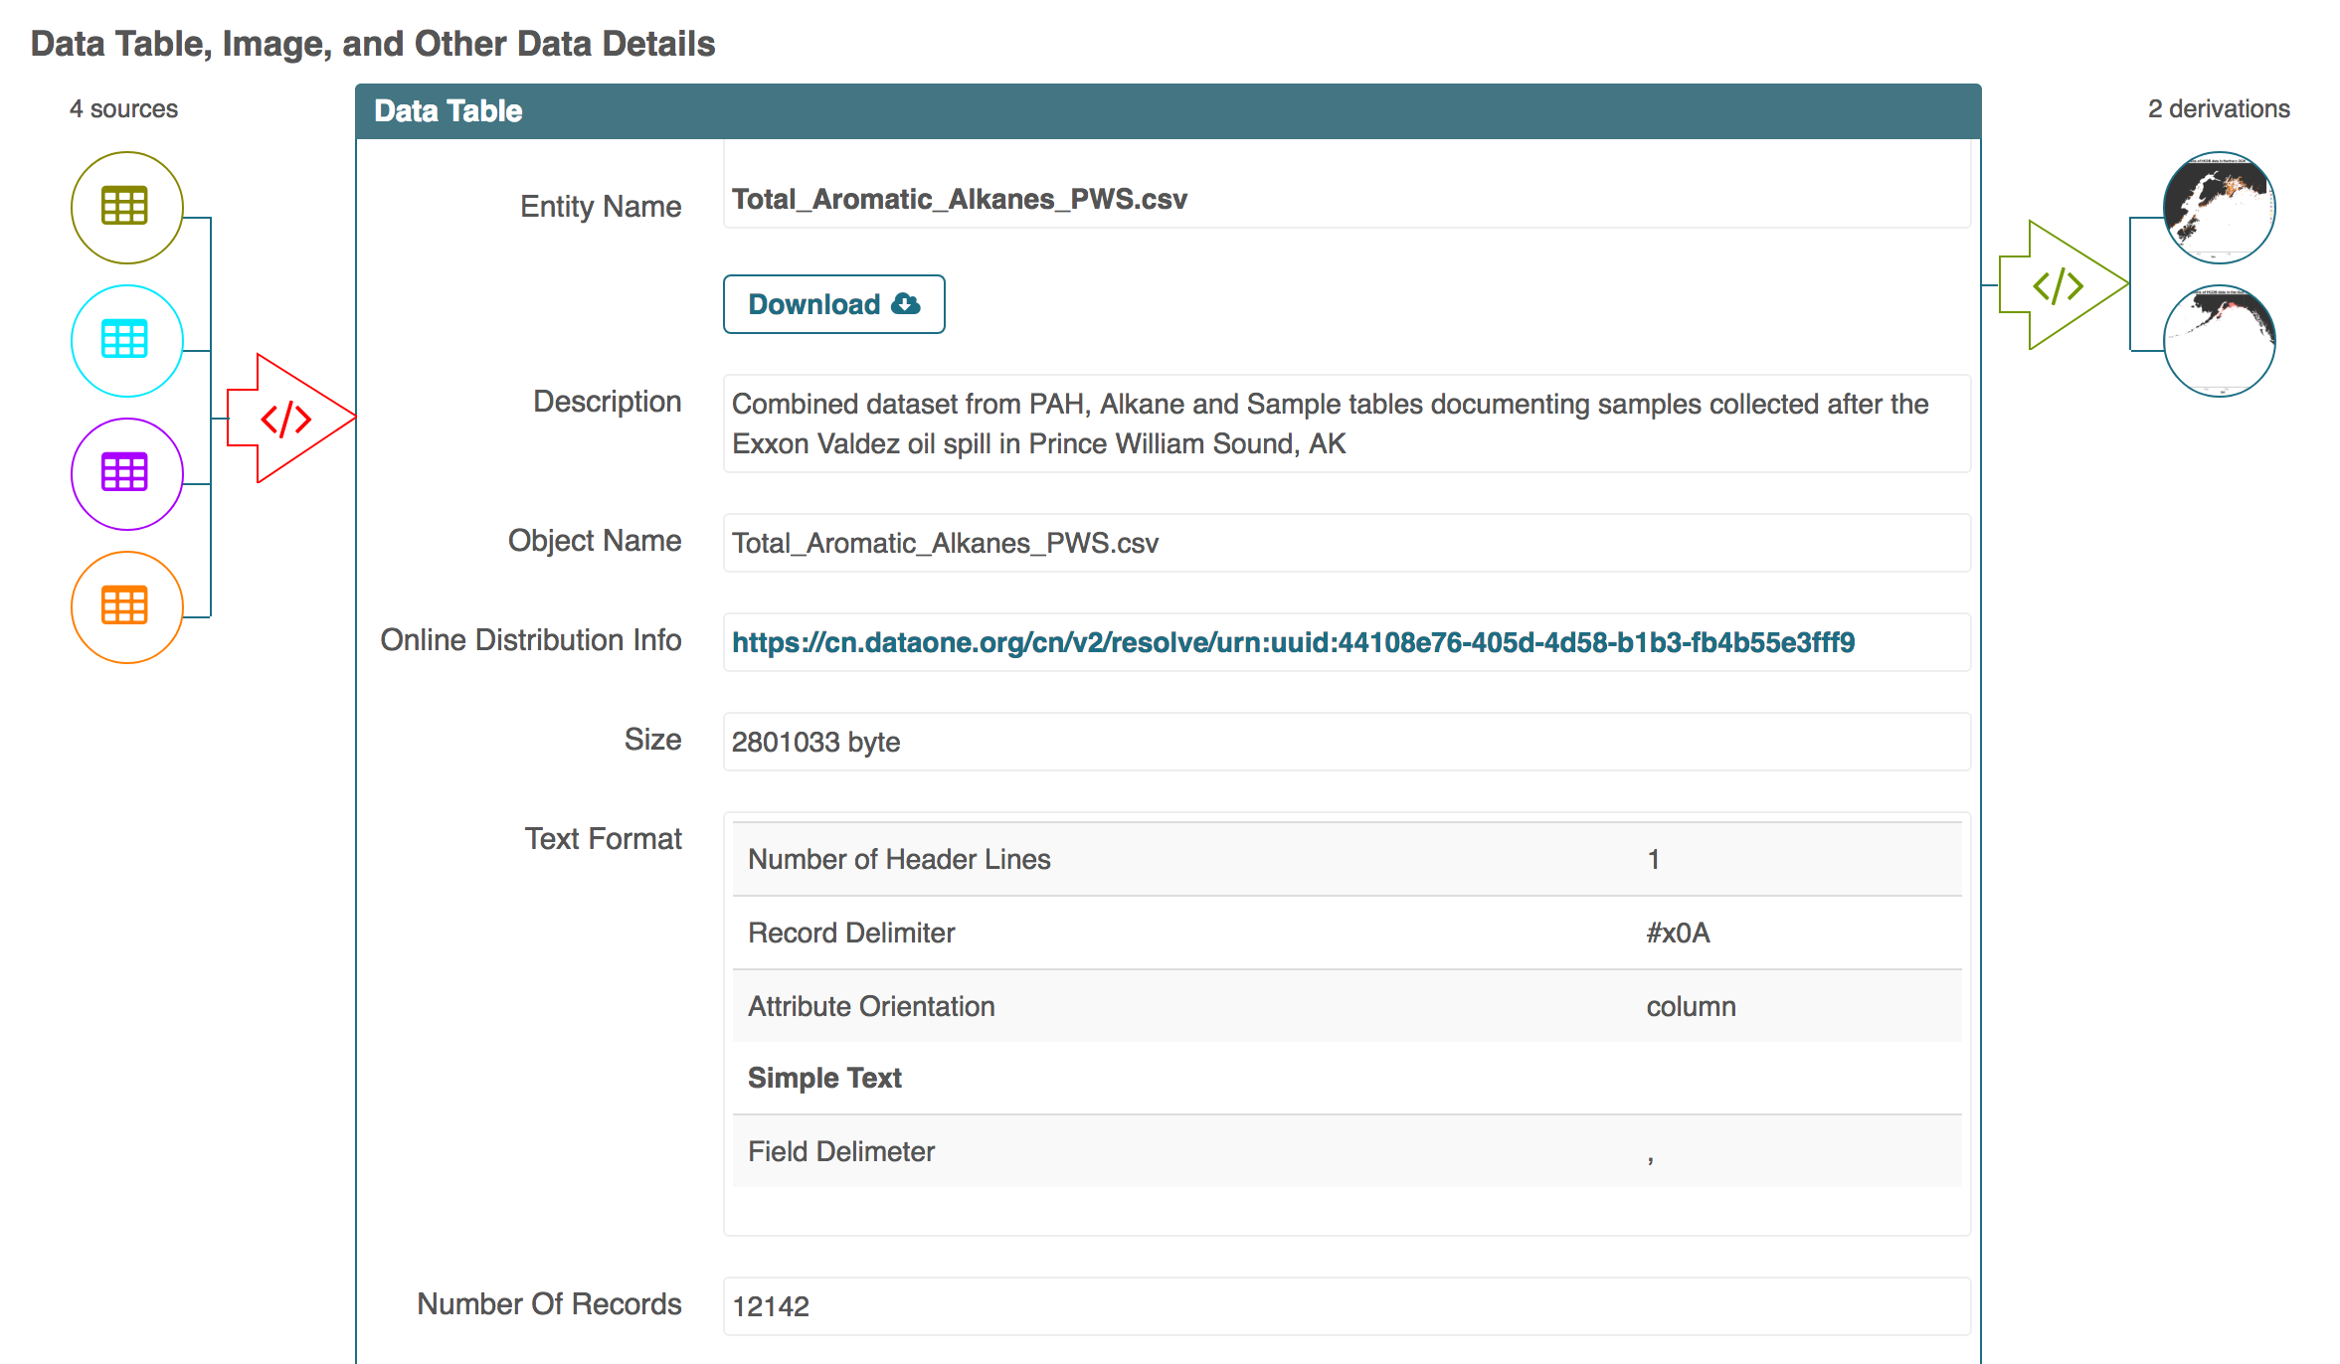

Slide 24
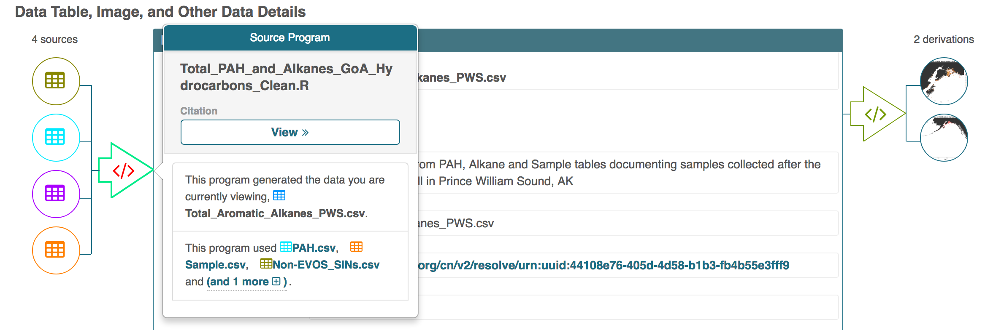

Slide 25
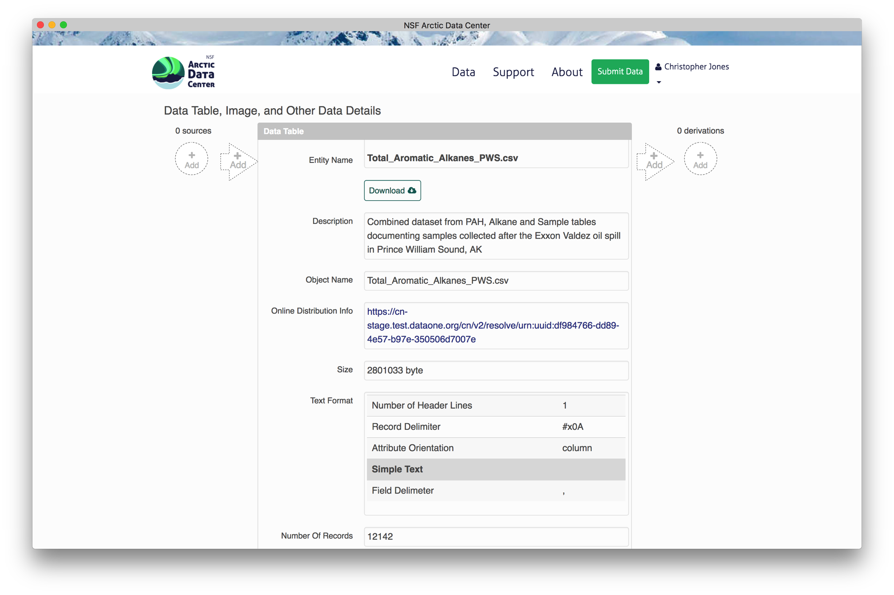
Web Provenance Editor
Deployed by Arctic Data Center

Slide 26
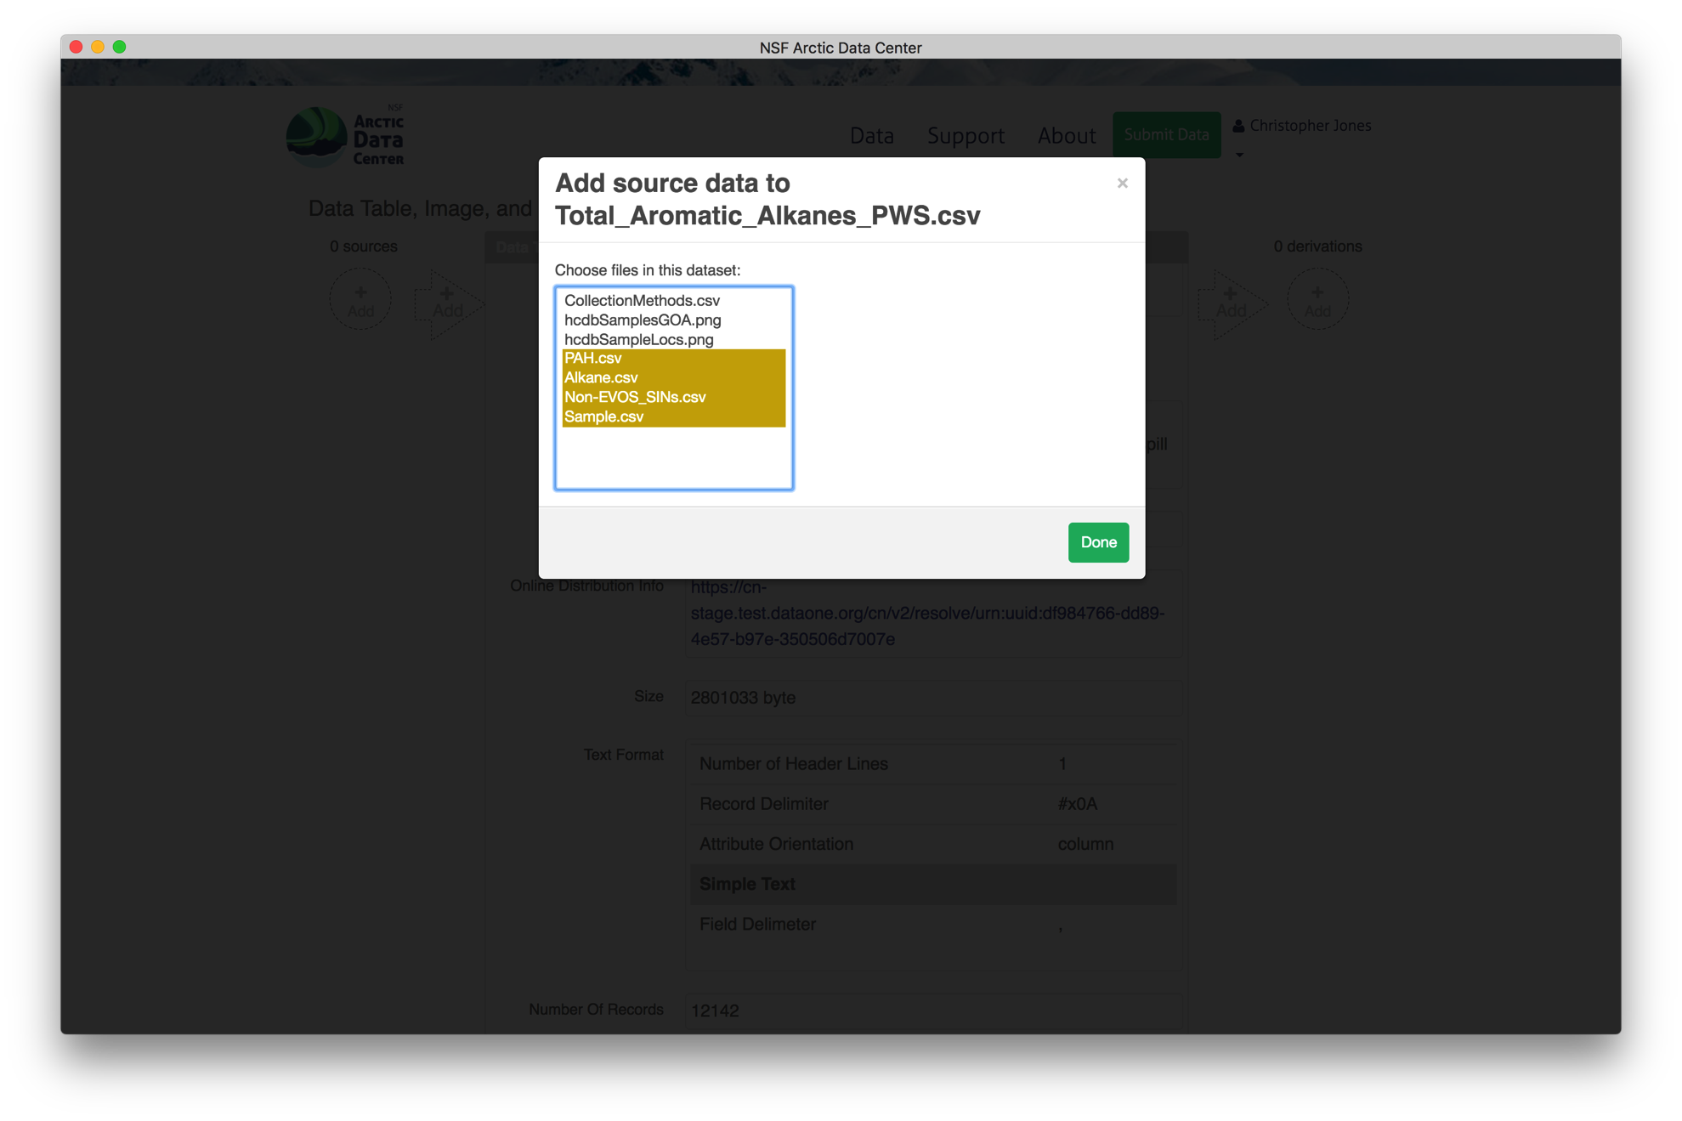

Slide 27
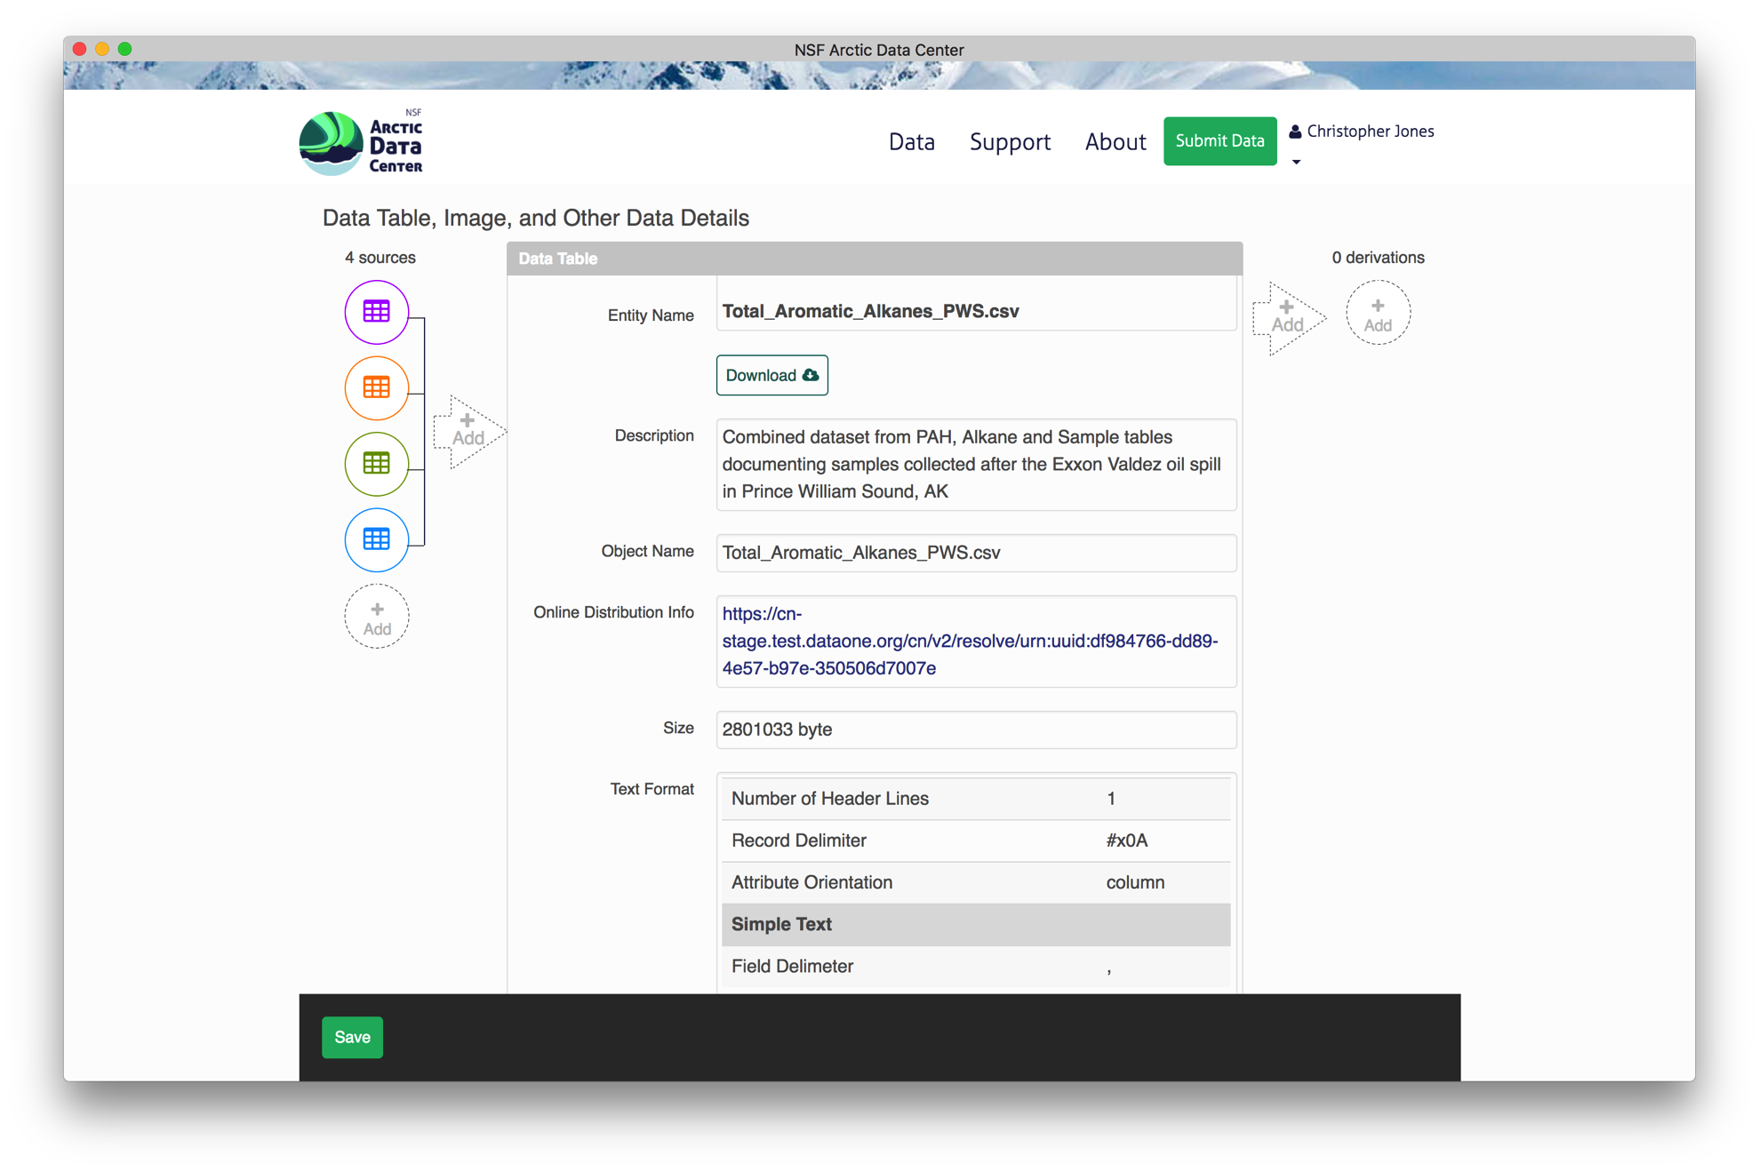

Slide 28
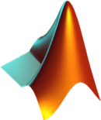

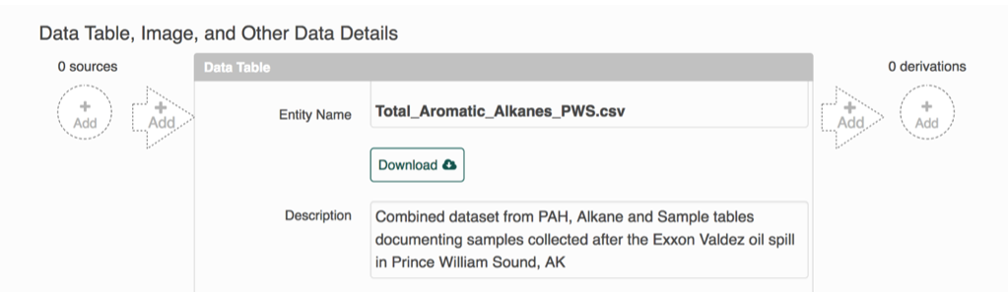

Provenance Editing
Matlab DataONE Toolbox
MetacatUI
Web Provenance Editor
Recordr R Library
YesWorkflow Tool
Notes:
BL: added YW icon

Slide 29


Reproducible
Science
Provenance
Citation
Synthesis
Notes:
Presented in several sections.
Provenance support in DataONE by Matt
an updated on Member Nodes
Mark Schildhauer will provide an update on semantic measurement search.
We’ll conclude with a brief outline of the ongoing and planned activities.

Slide 30
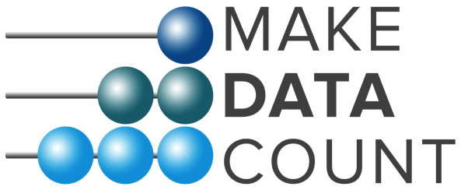



Credit where credit is due
Indexing and exposing data citations
in international data repository networks

Slide 31
Force11 Data Citation Principles
1. Importance of data citation
2. Credit and Attribution
3. Evidence
4. Unique Identification
5. Access
6. Persistence
7. Specificity and Verifiability
8. Interoperability and Flexibility
Joint Declaration of Data Citation Principles, https://doi.org/10.25490/a97f-egyk

Slide 32
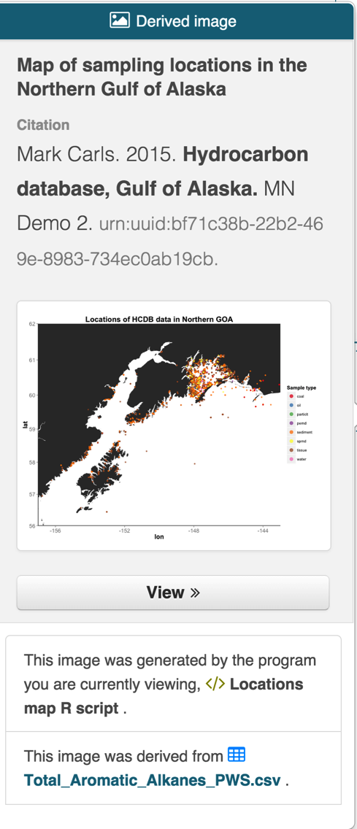
Transitive Credit
When a user cites a pub, we know:
Which data produced it
What software produced it
What was derived from it
Who to credit down the attribution stack
See: Katz & Smith. 2014. Implementing Transitive Credit with JSON-LD. arXiv:1407.51

Slide 33
Citing multi-generational workflows
Transitive Credit
Via
Provenance
Citation in paper
doi:
Dataset C
Dataset D
Dataset A
Dataset E
Dataset B
Dataset F

Slide 34


Evolution of the Living Paper
Scholarly Publications
1st Gen | Prose
2nd Gen | Prose | + Data
3rd Gen | Prose | + Data | + Code
Prose + Data + Code + Provenance
Prose + Data + Code + Provenance + Execution Environment
WHOLEtale

Slide 35
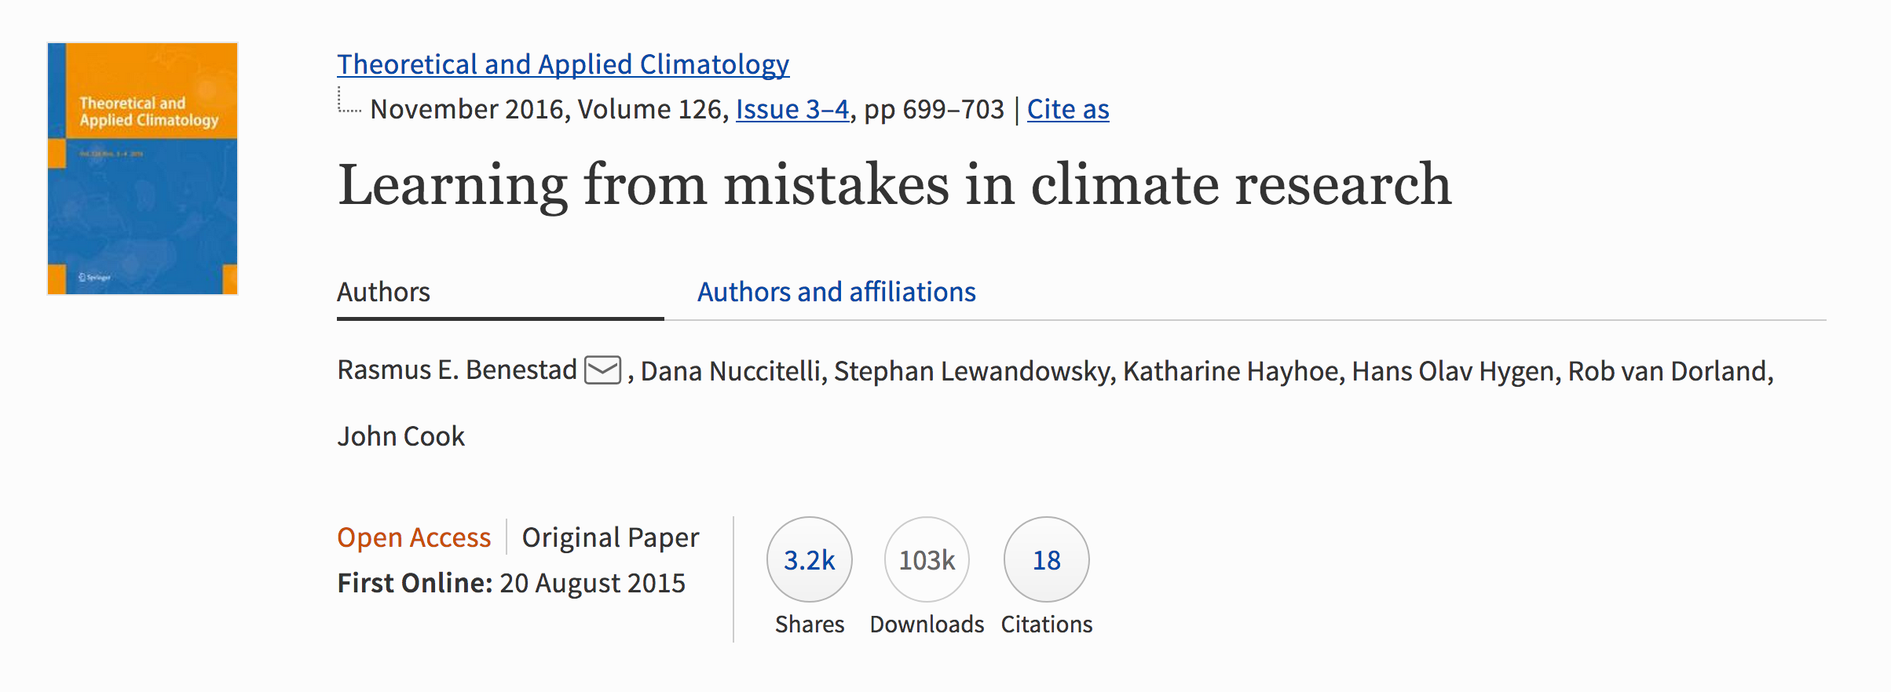

Slide 36
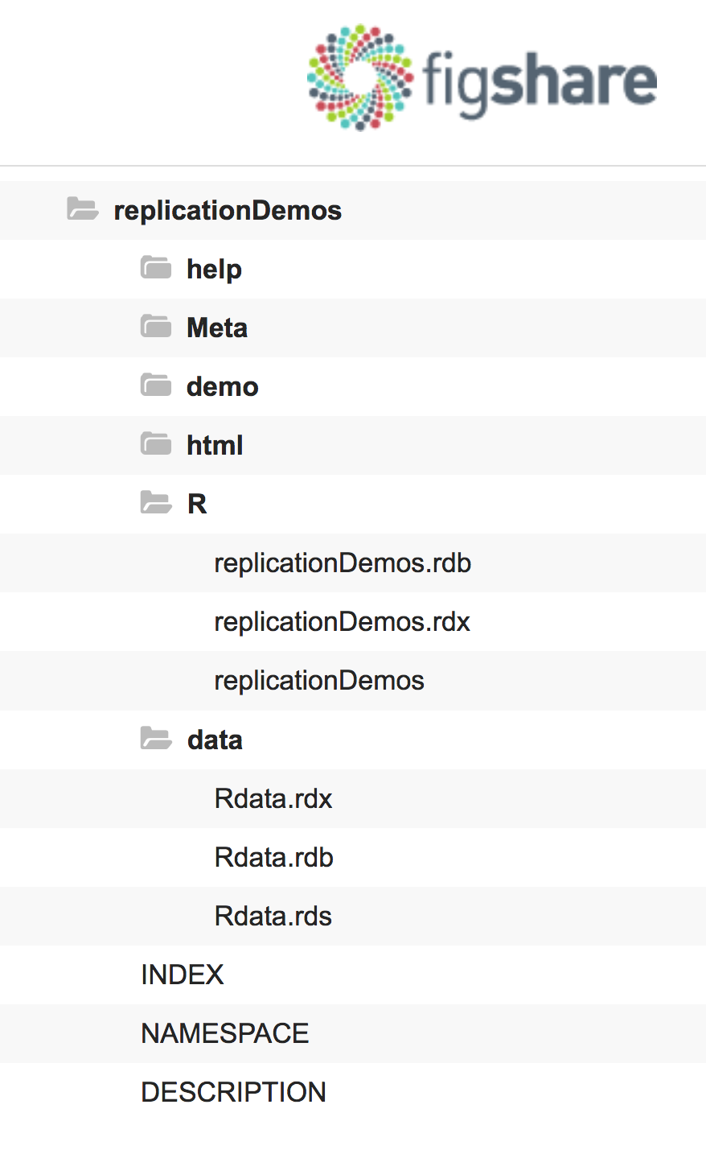
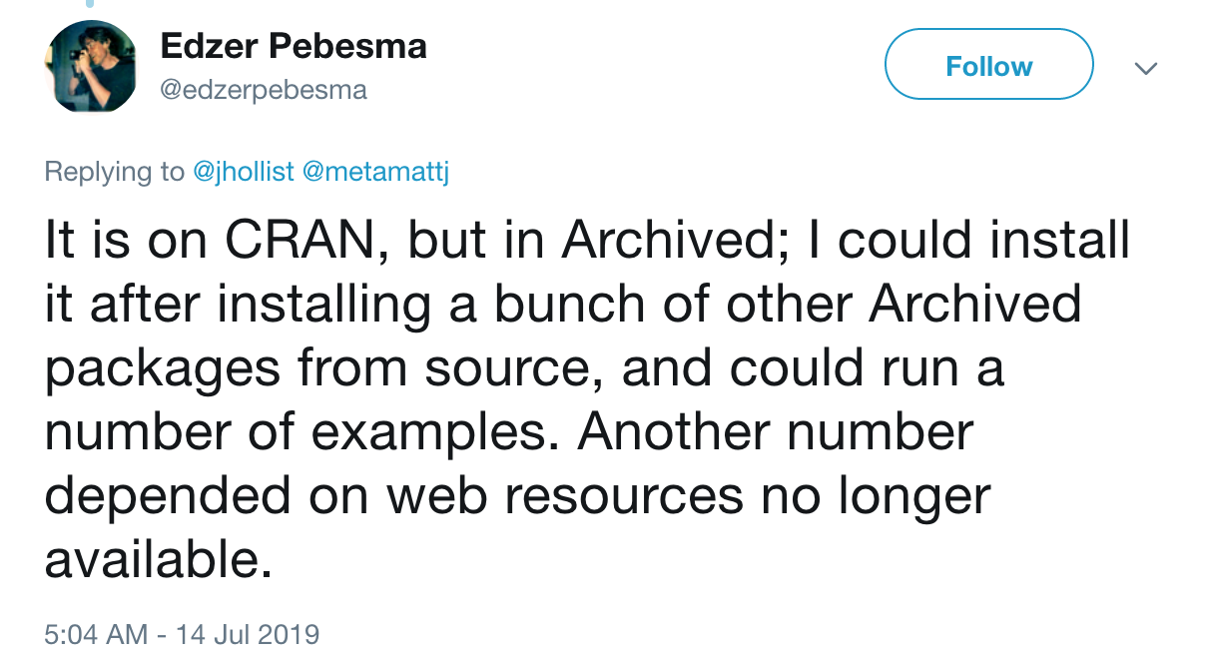
Ships with an R package

Slide 37
Parsing Reproducibility
Empirical Reproducibility:
traditional empirical experiments, e.g. at the bench/lab
Statistical Reproducibility:
statistical methodology used permits generalizability of data inferences
Computational Reproducibility:
transparency of computational steps that produce scientific findings
V. Stodden. (2013). Resolving Irreproducibility in Empirical and Computational Research. IMS Bulletin
Notes:
IMS Bulletin: http://bulletin.imstat.org/2013/11/resolving-irreproducibility-in-empirical-and-computational-research/
BL: if this comes up -- (i) simplifying reproducibility (sensu Claerbout/Donoho/Peng)
and (ii) facilitating replicability (different methods), i.e., empowering users to do that, too!

Slide 38
Simplifying Computational Reproducibility in Whole Tale
Researchers can easily package and share tales:
Data, Code, and Compute Environment
to re-create the computational results from a scientific study
achieving computational reproducibility
thus “setting the default to reproducible.”
Also empowers users to verify and extend results with different data, methods, and environments.
V. Stodden, D. H. Bailey, J. Borwein, R. J. LeVeque, W. Rider, and W. Stein. (2013). Setting the Default to Reproducible: Reproducibility in Computational and Experimental Mathematics, ICERM workshop (2013)
Notes:
(Terminology is based on Claerbout/Donoho/Peng! (not ACM), see, e.g. [Barba2018])
Reproducible research: Authors provide all the necessary data and the computer codes to run the analysis again, re-creating the results.
(Replication: A study that arrives at the same scientific findings as another study, collecting new data (possibly with different methods) and completing new analyses).

Slide 39
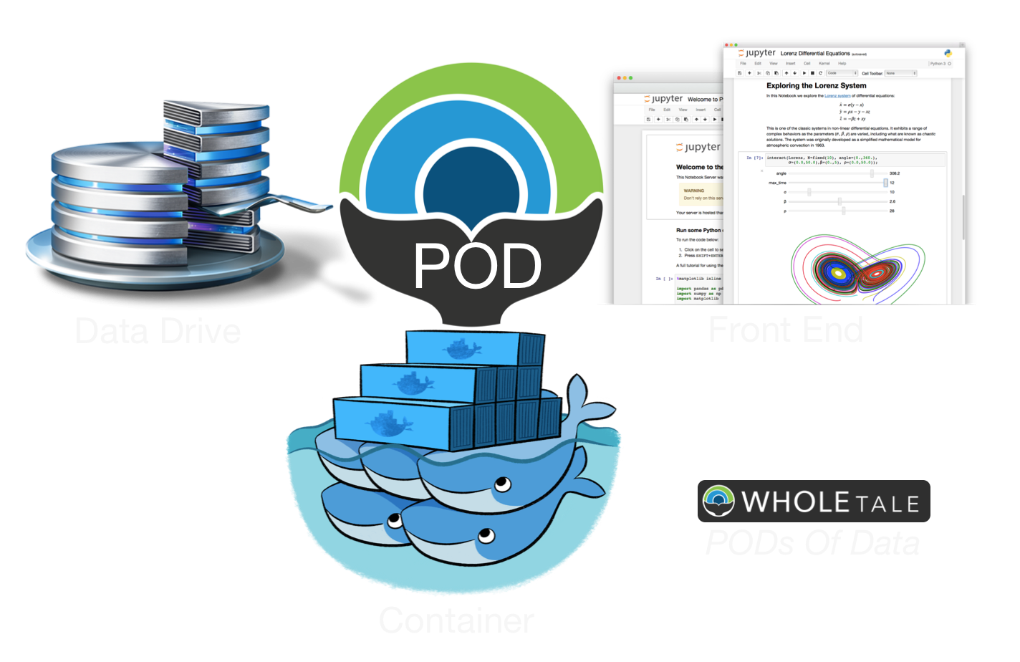
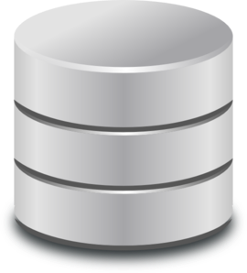



What exactly is (in) a Tale?
Tale = executable research object, i.e.
data (references)
+ code (computational methods)
+ narrative (traditional science story)
+ compute environment (e.g. RStudio, Jupyter)
Captured in a standards-based tale format complete with metadata
Code/Narrative
Data
Compute environment
Notes:
Bertram resumes here!
Occasionally (e.g. during the 18 month review ;-) the question comes up:
What exactly is a tale?
.. and what goes inside of it.
Well here you go …

Slide 40
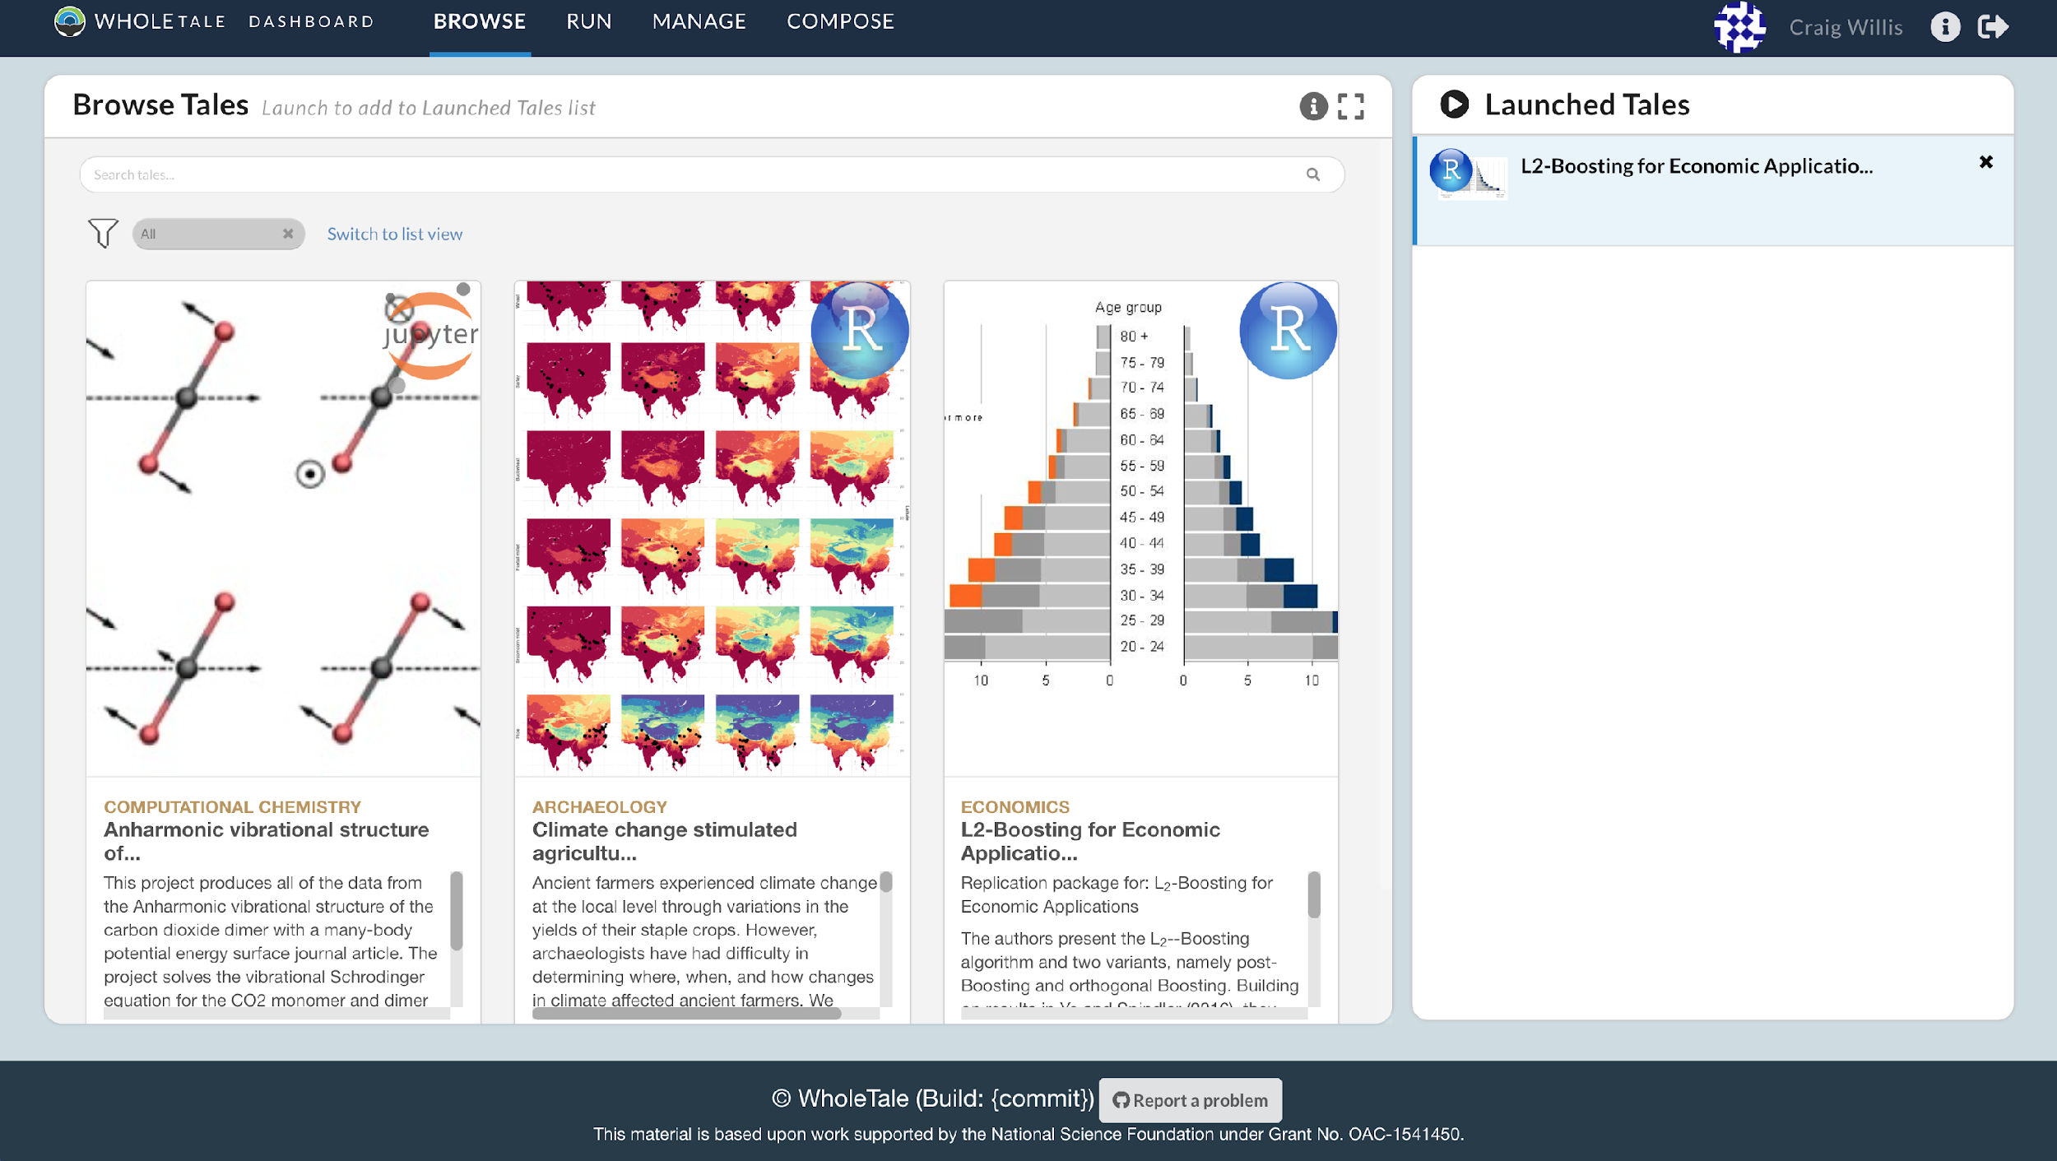
Browse
Existing
Tales …
Notes:
To fill these somewhat abstract notions with life, let me give you a very quick overview on tales.
Much more detail will be demonstrated in the following presentations.
For starters, when you go to the so-caled WT dashboard you can start by browsing existing tales, e.g.
.. here’s an image from a computational chemistry tale
… an archaeology / paleo-climate reconstruction tale
… and a social science / economics tale

Slide 41
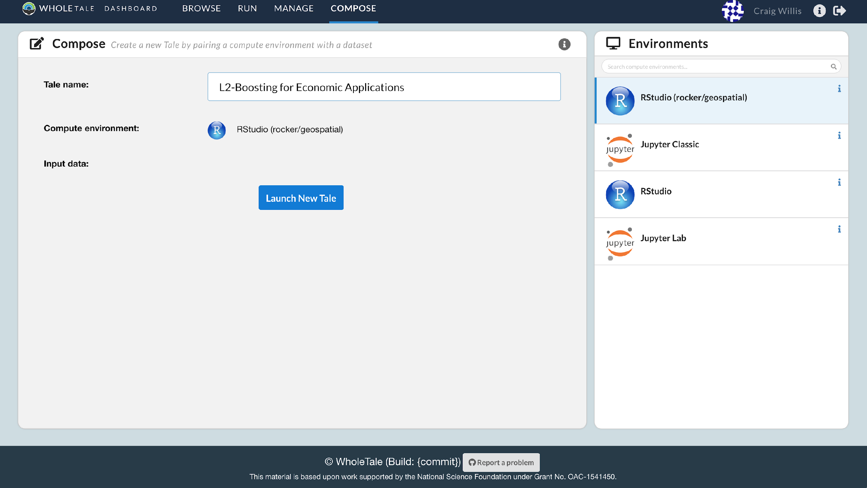
… Compose New Tales …
Notes:
… of course it should also be really easy to CREATE NEW TALES!
And indeed it is: You need as little as a name for a tale, a compute environment (e.g., a Jupyter notebook or an RStudio env),
you typically would also select some uniquely identified data to work with and you’re off to the races!

Slide 42
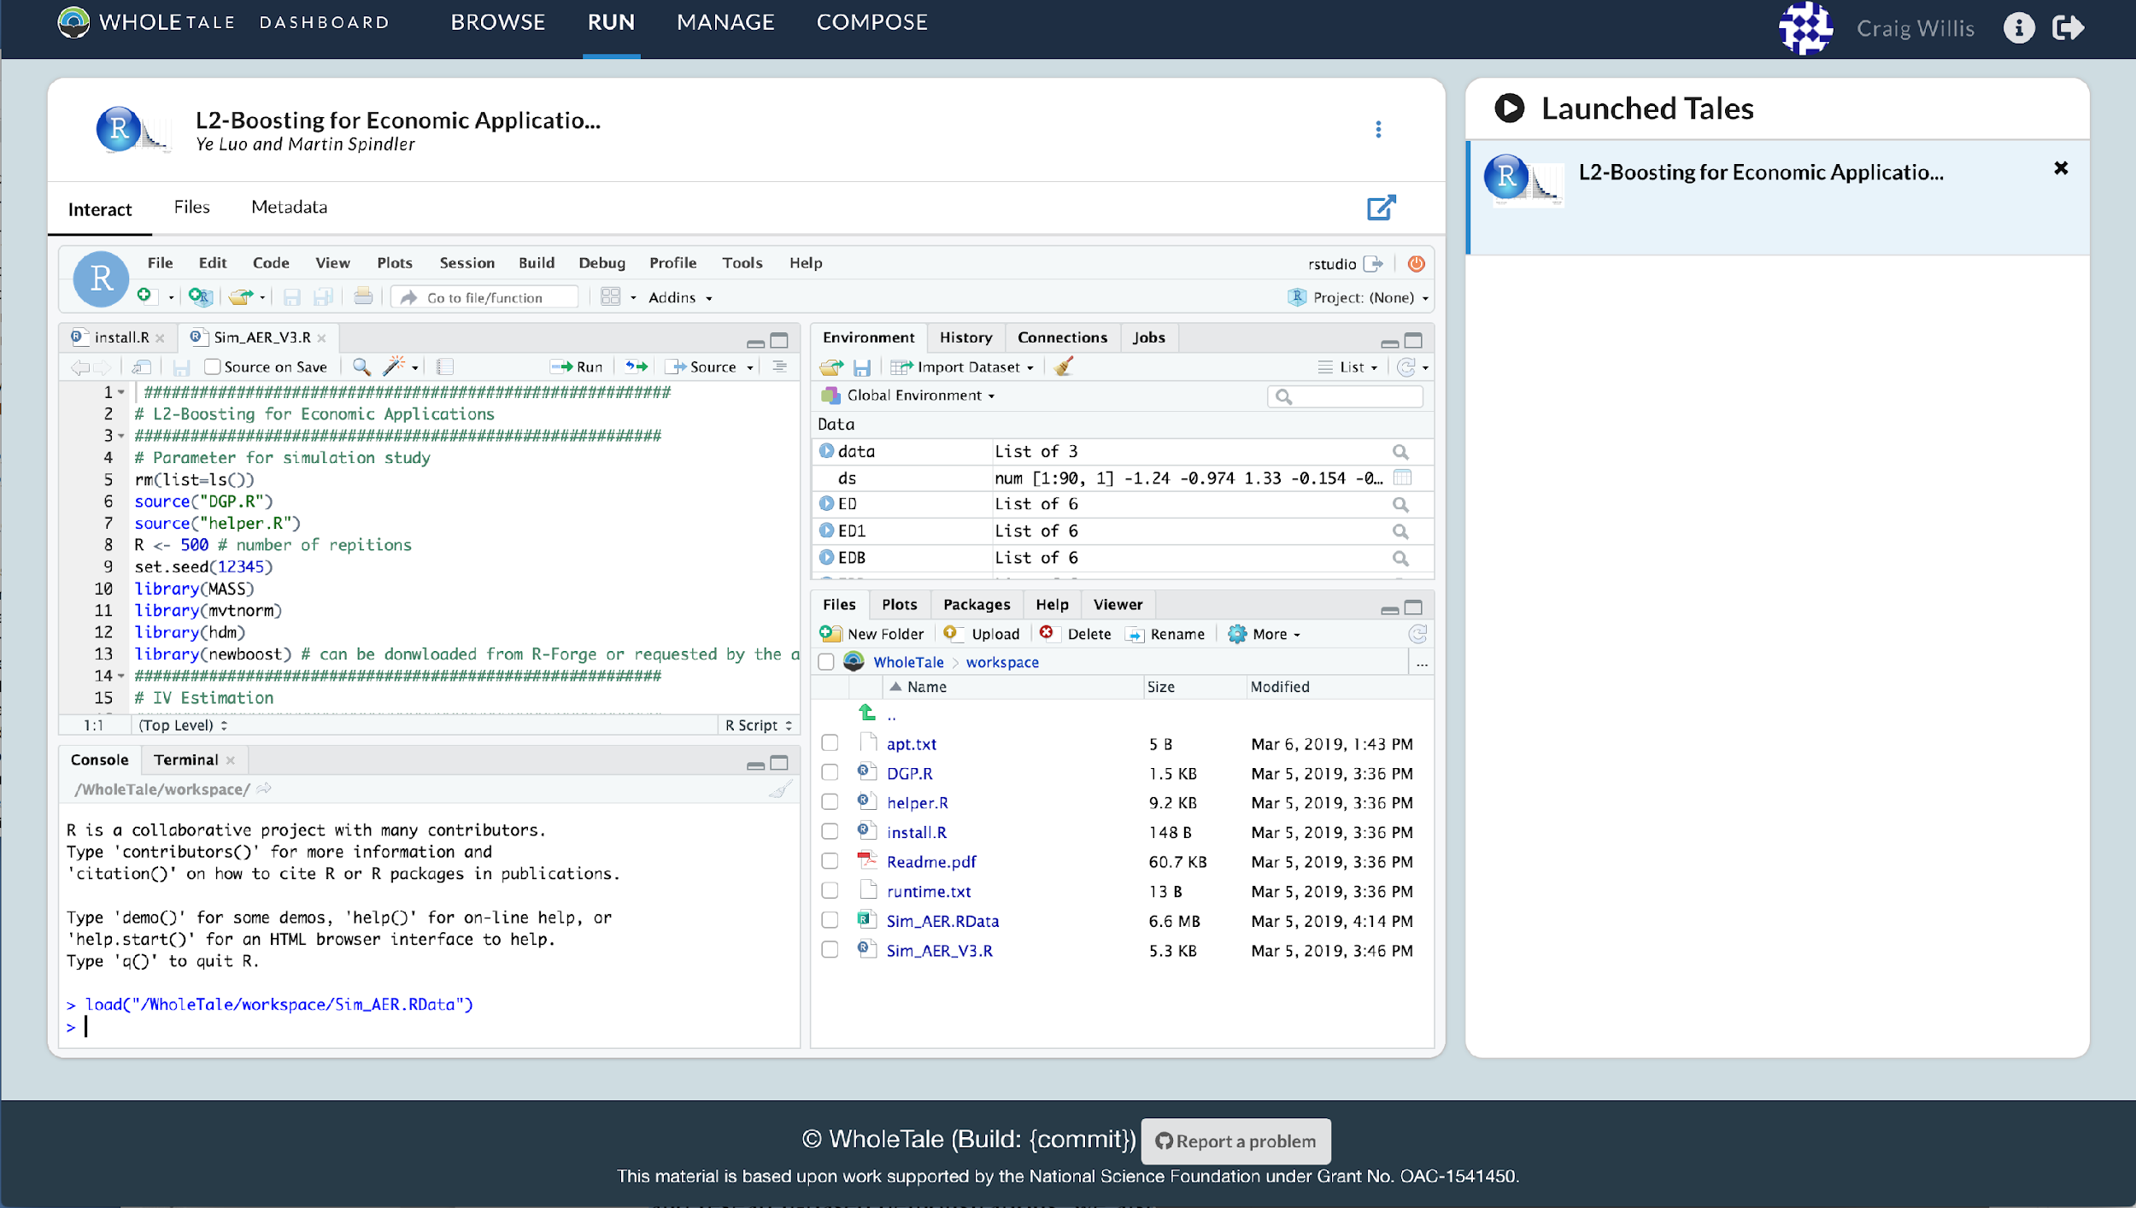
…
Run &
Interact
with Tales …
Notes:
Now what’s really cool about those tales, whether they’re your own or someone else’s: you get to see the compute environment that the tale author has used for their computational study / data analysis: you can re-execute the code given by original tale authors on the original data, in the original compute environment.
How’s that for sharing the experience of comp. sci., data sci., and everything in-between?
You want to reproduce the figure from the paper associated with this tale? All figures?
The tale creator can give you all of this easily (and you can re-run it.. possibly, if you want, with some changes!)

Slide 43
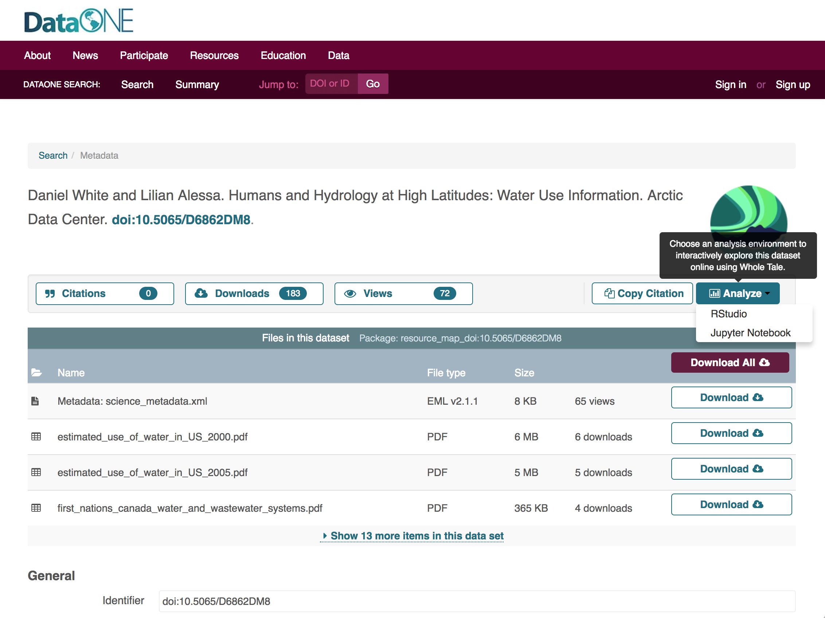
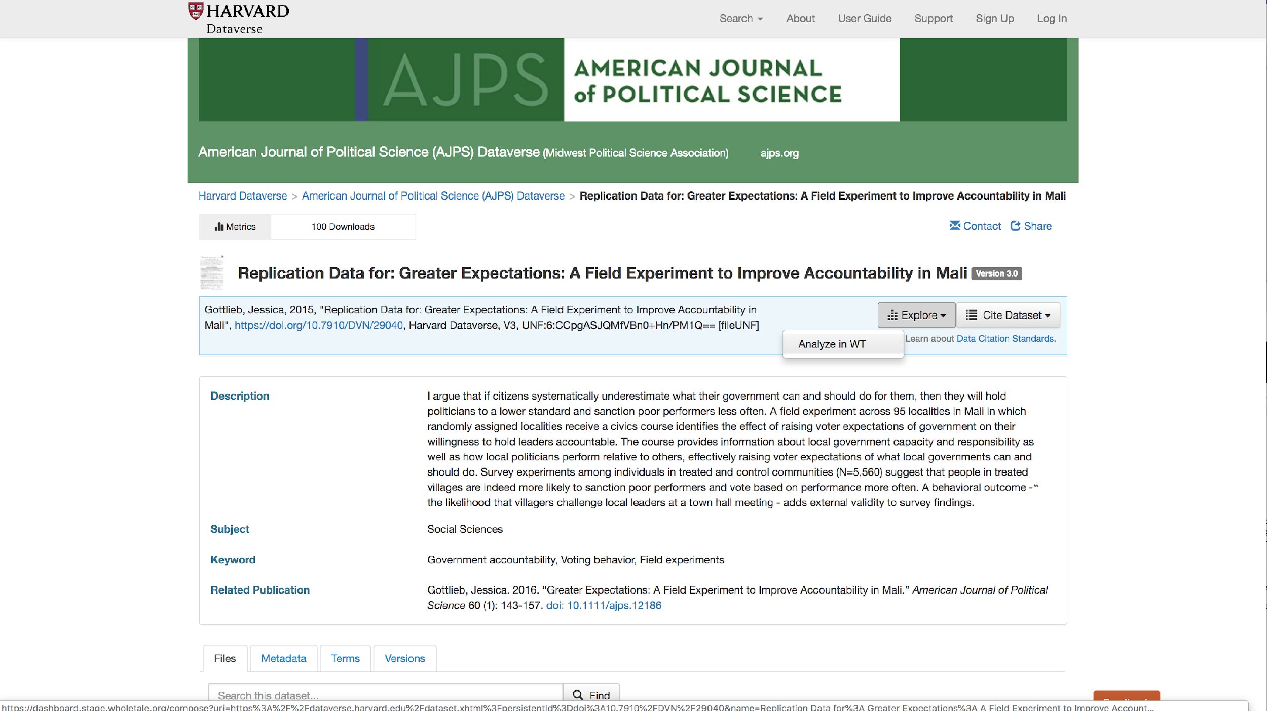
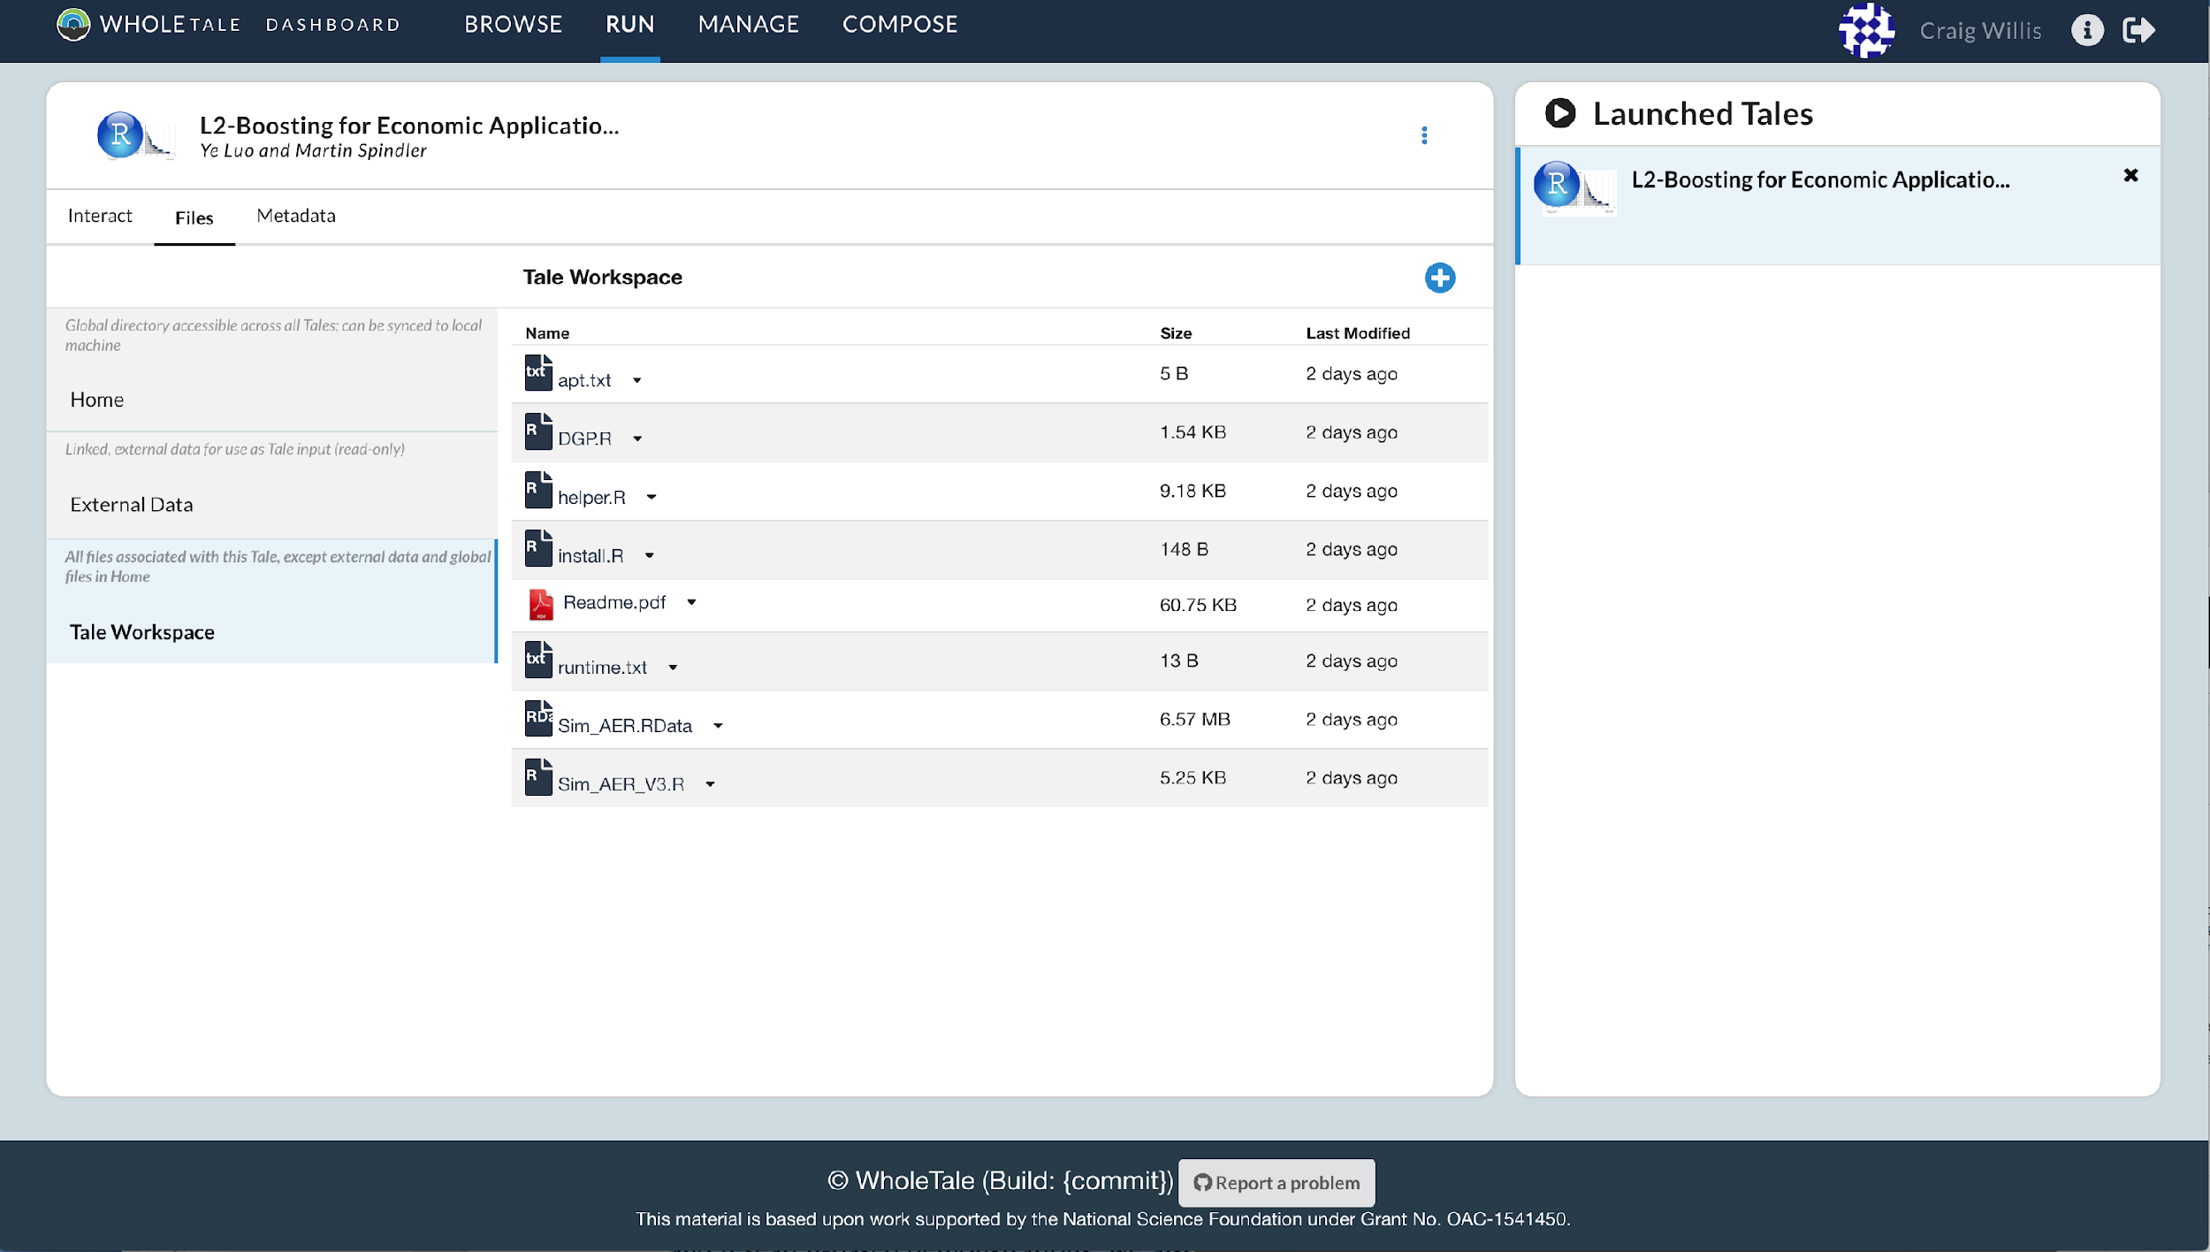
Tale
Workspace
… Integrate Data Repos with
Whole Tale!
Enables turnkey exploratory data analysis on existing published datasets
DataONE and Dataverse networks cover > 90 major research repositories!
Launch
in WT
Notes:
Now here I want to draw you attention to one of the key milestones and deliverables we were tasked with: Integration of WT with major repositories.
We already had planned integration of WT with DataONE, a federation of several dozen science repositories. Through our community engagement and outreach activities (of which you will hear more), we were also able to integrate with Dataverse. Between DataONE and Dataverse we now have over 90 major research repositories from which a user can select datasets and then make those datasets the starting point of an interactive data exploration and analysis inside of one of the Whole Tale environments.
I know this is extremely exciting… but I have to ask you to hold your breath.. there will be a demo coming!
Just for the record: This is “Whole Tale Integrated” the Year 3 milestone! Integration with major repositories -- it’s done!
More on the details in due course. But we’re all very excited about this!
(Phil Durbin from Dataverse was at our last year’s Workshop on Tools for Reproducible Research .. the Dataverse integration is one of the outcomes..)

Slide 44

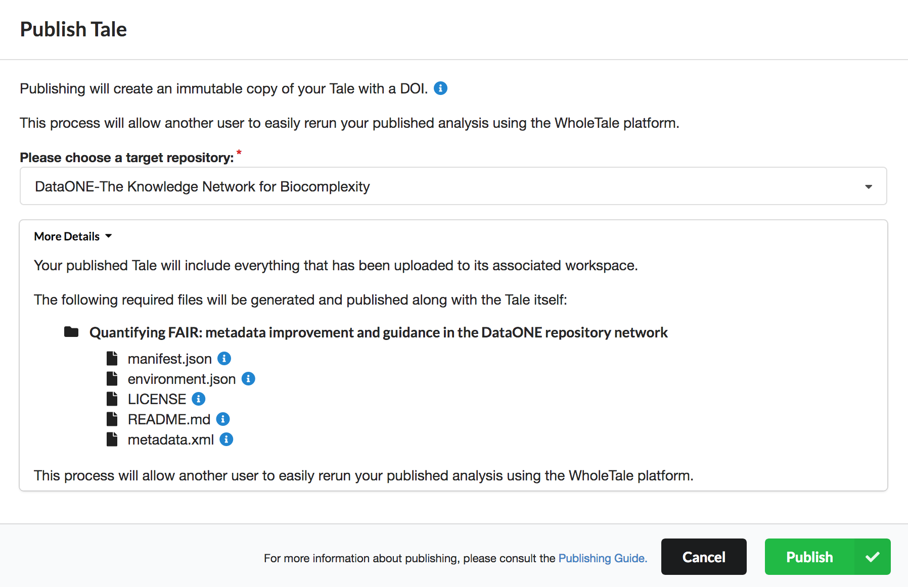
… Publish Data, Code, and Environment
Tale
Workspace
Enables full circle reproducibility to DataONE repositories that accept API deposits
Launch
in WT
Notes:
Now here I want to draw you attention to one of the key milestones and deliverables we were tasked with: Integration of WT with major repositories.
We already had planned integration of WT with DataONE, a federation of several dozen science repositories. Through our community engagement and outreach activities (of which you will hear more), we were also able to integrate with Dataverse. Between DataONE and Dataverse we now have over 90 major research repositories from which a user can select datasets and then make those datasets the starting point of an interactive data exploration and analysis inside of one of the Whole Tale environments.
I know this is extremely exciting… but I have to ask you to hold your breath.. there will be a demo coming!
Just for the record: This is “Whole Tale Integrated” the Year 3 milestone! Integration with major repositories -- it’s done!
More on the details in due course. But we’re all very excited about this!
(Phil Durbin from Dataverse was at our last year’s Workshop on Tools for Reproducible Research .. the Dataverse integration is one of the outcomes..)

Slide 45
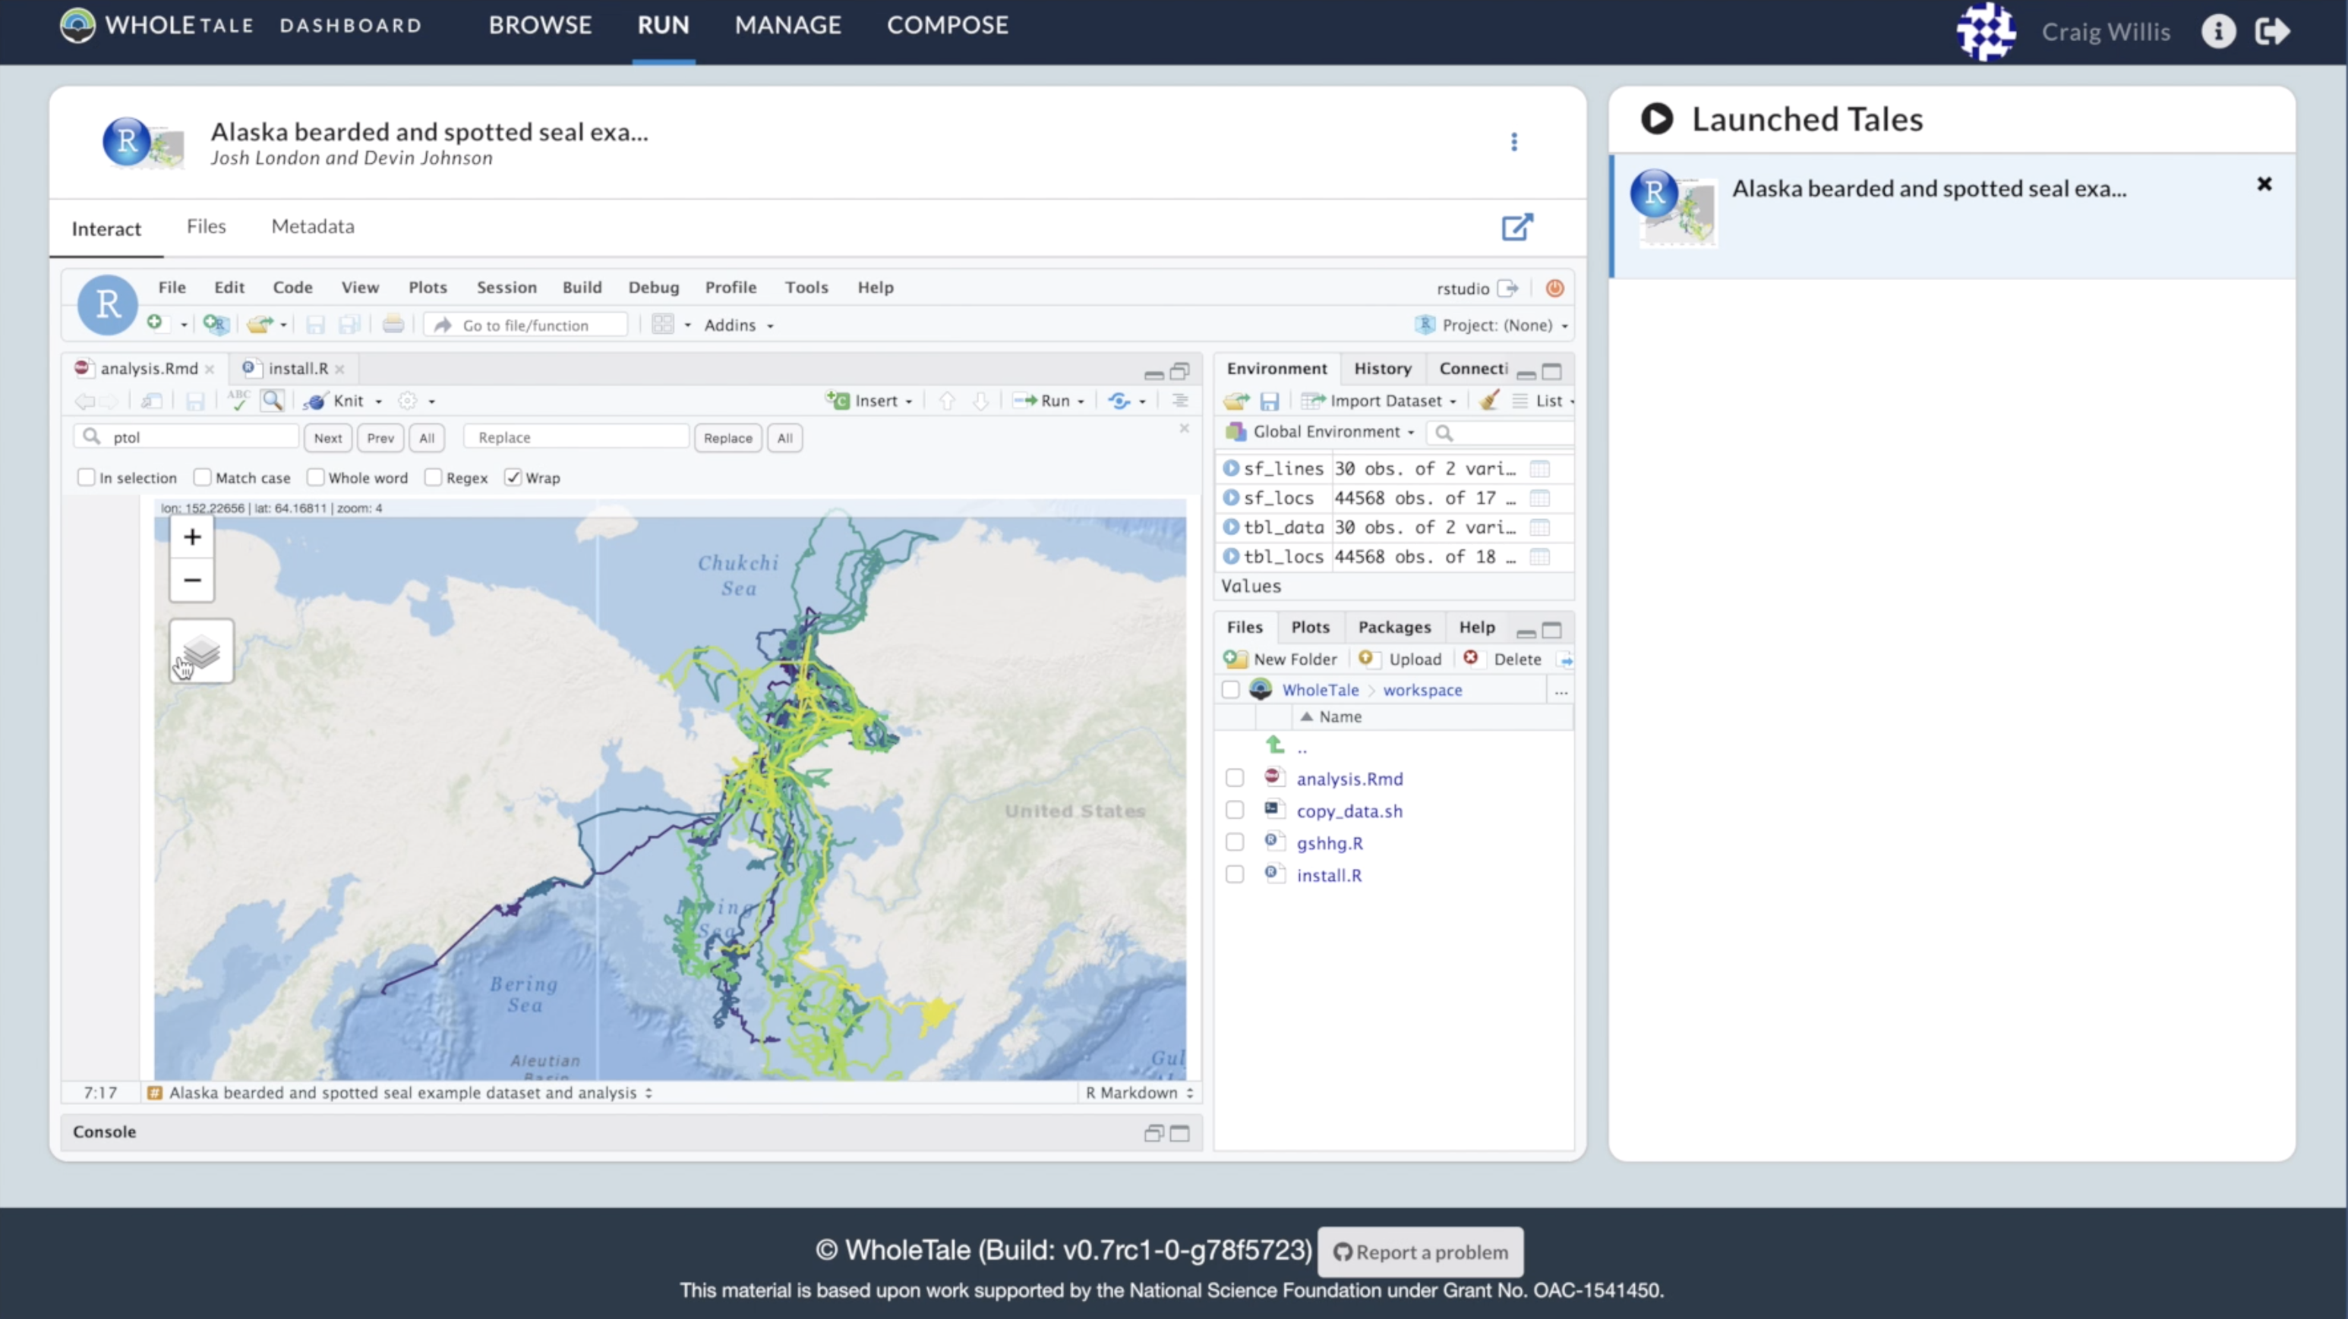
Whole Tale Forecast Demo
Demonstration of a model to predict the movement paths of seals using satellite telemetry data.
Based on analysis and models by:
Josh London and Devin Johnson
NOAA Marine Mammal Laboratory
https://youtu.be/Ml5d7r5OtCk

Slide 46


Reproducible
Science
Provenance
Citation
Synthesis
Notes:
Presented in several sections.
Provenance support in DataONE by Matt
an updated on Member Nodes
Mark Schildhauer will provide an update on semantic measurement search.
We’ll conclude with a brief outline of the ongoing and planned activities.

Slide 47
State of Alaska’s Salmon and People
8 SASAP working groups
1: Bio-physical State of Knowledge of Salmon Distribution & Habitat
Leads: Peter Westley and Dan Rinella
2: Sociocultural and Economic Dimensions of Salmon Systems
Leads: Courtney Carothers, Jessica Black, Tobias Schworer
3: Governance and Subsistence
Leads: Steve Langdon, Taylor Brelsford, James Fall
4: Consistency, Causes, and Consequences of Declining Size and Age of Alaskan Salmon
Leads: Eric P. Palkovacs, Peter Westley, Bert Lewis
5: Well-Being and Alaska Salmon Systems
Leads: Rachel Donkersloot, Jessica C. Black, Courtney Carothers
6: Interacting Effects of Ocean Climate and At-Sea Competition on Alaskan Salmon
Leads: Peter S. Rand, Robert W. Campbell, Kristen B. Gorman
7: Using Participatory Modeling to Empower Community Engagement in Salmon Science
Leads: Michael L. Jones
8: Kenai Lowlands Salmon Research Synthesis and Design Tools for Integrated Watershed Management
Leads: Coowe Walker, Mark Rains, Ryan King, Charles Simenstad, Dennis Whigham

Slide 48
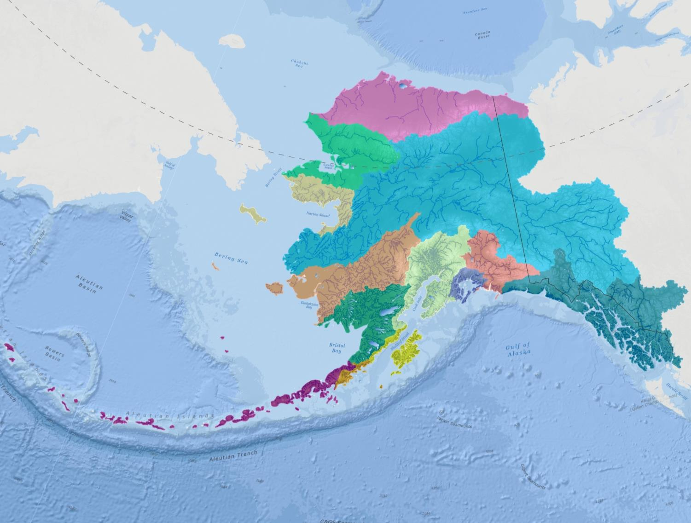
Regional integration
map-illustration-by: Dr. Leslie Jones
map-illustration-by: Dr. Leslie Jones

Slide 49
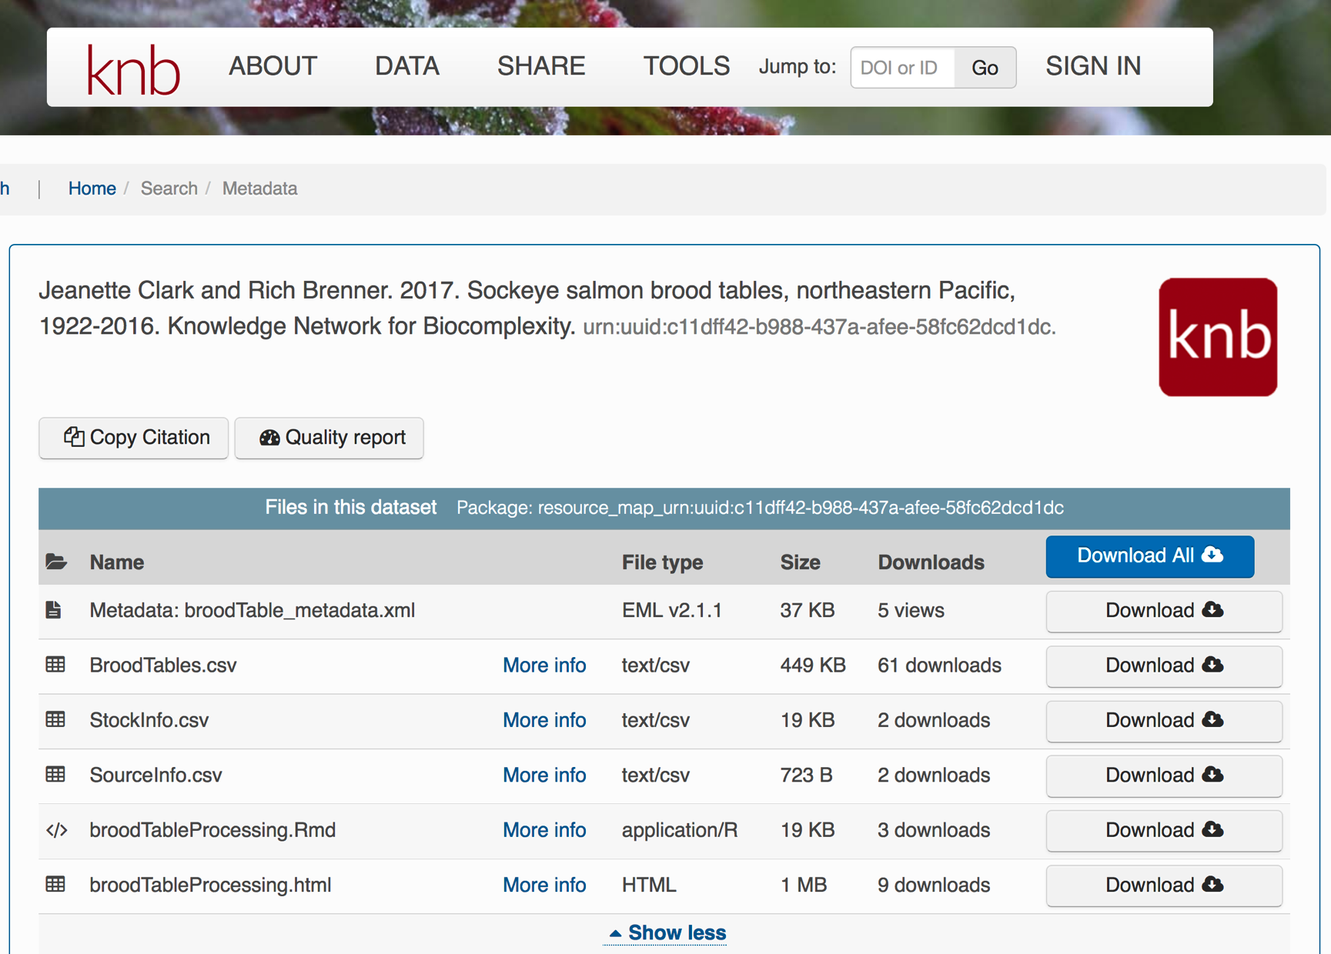

Slide 50
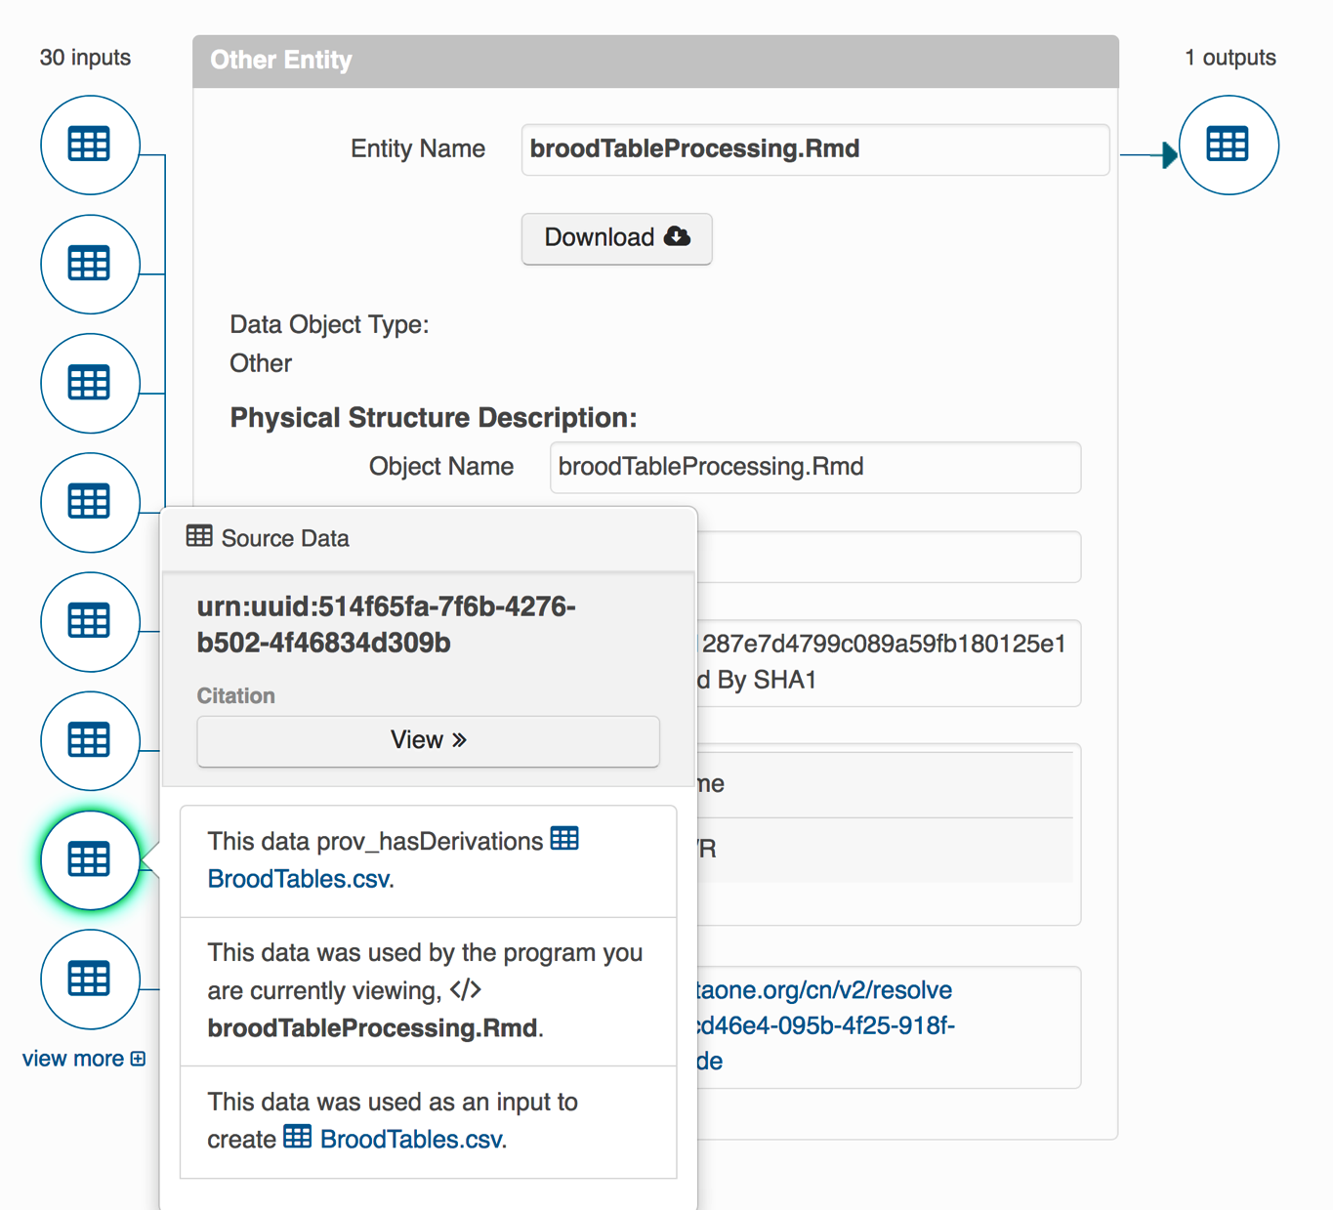

Slide 51
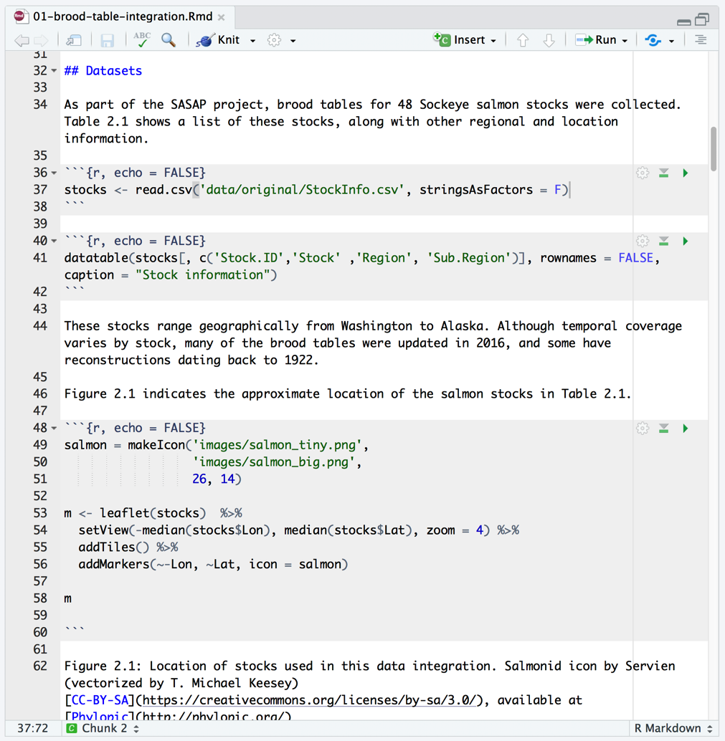
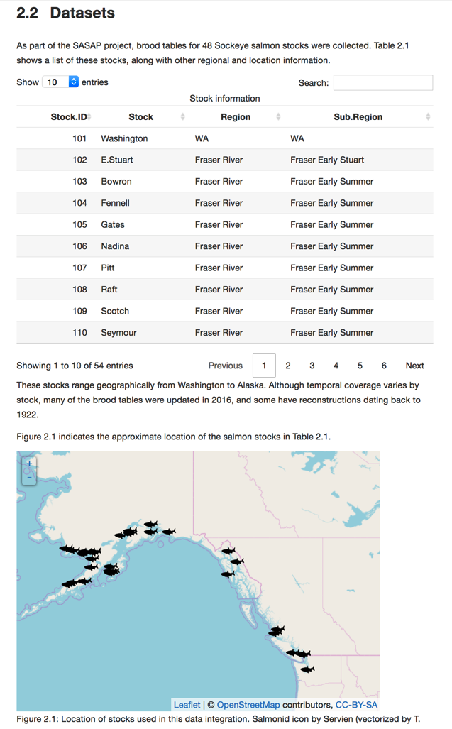
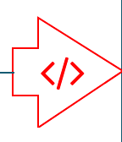
Rmarkdown as Provenance

Slide 52

KNB Salmon Data Portal

Slide 53

Foundational Infrastructure
Providing findable, accessible data with interoperable infrastructure enabling long term data reuse for synthesis
https://www.force11.org/fairprinciples

